Slide 1

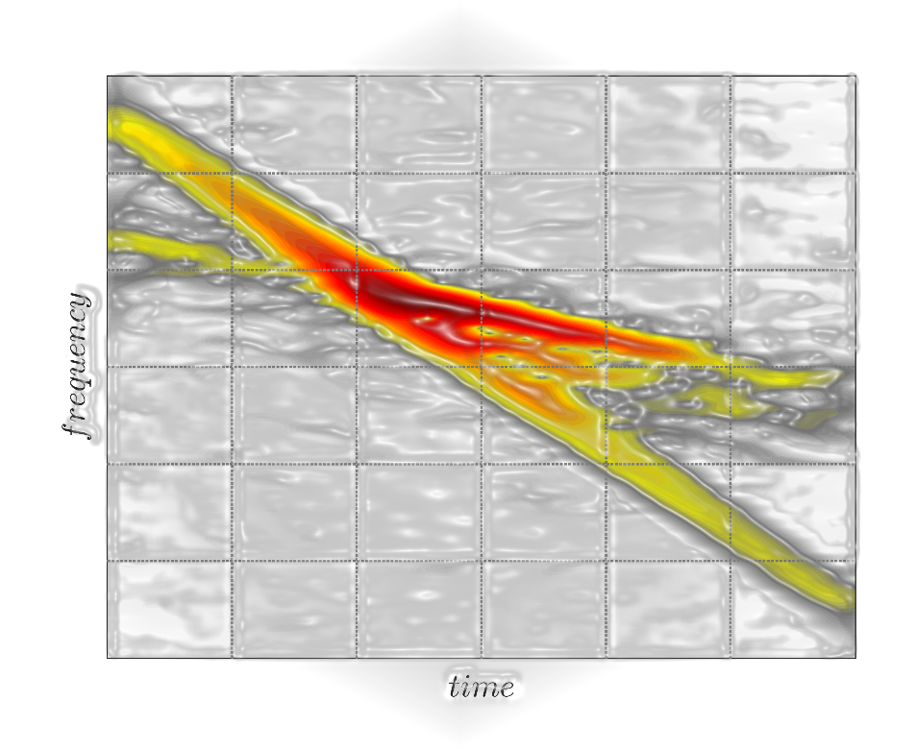



Identification of linear time-variant rotor components in resonance crossing Experimental validation
Davide Iaffaldano, Luigi Carassale
Dynamics & Monitoring Lab, University of Genova
Roberto Guida
Ansaldo Energia, Genova
Notes:
Experimantal validation of techniques for

Slide 2
Overview
1. Introduction. Modal identification of rotor components
2. Key features of resonance crossing. Linear time variant nature of system
3. Experimental setup.
4. Wavelet probing. Theorical background
5. Motivation. Analysis of LTV system needs something more
6. Proposed methods for LTV identification. It’s a matter of rotating
7. Results and conclusions.
Notes:
Le me introduce my work with a brief summary

Slide 3
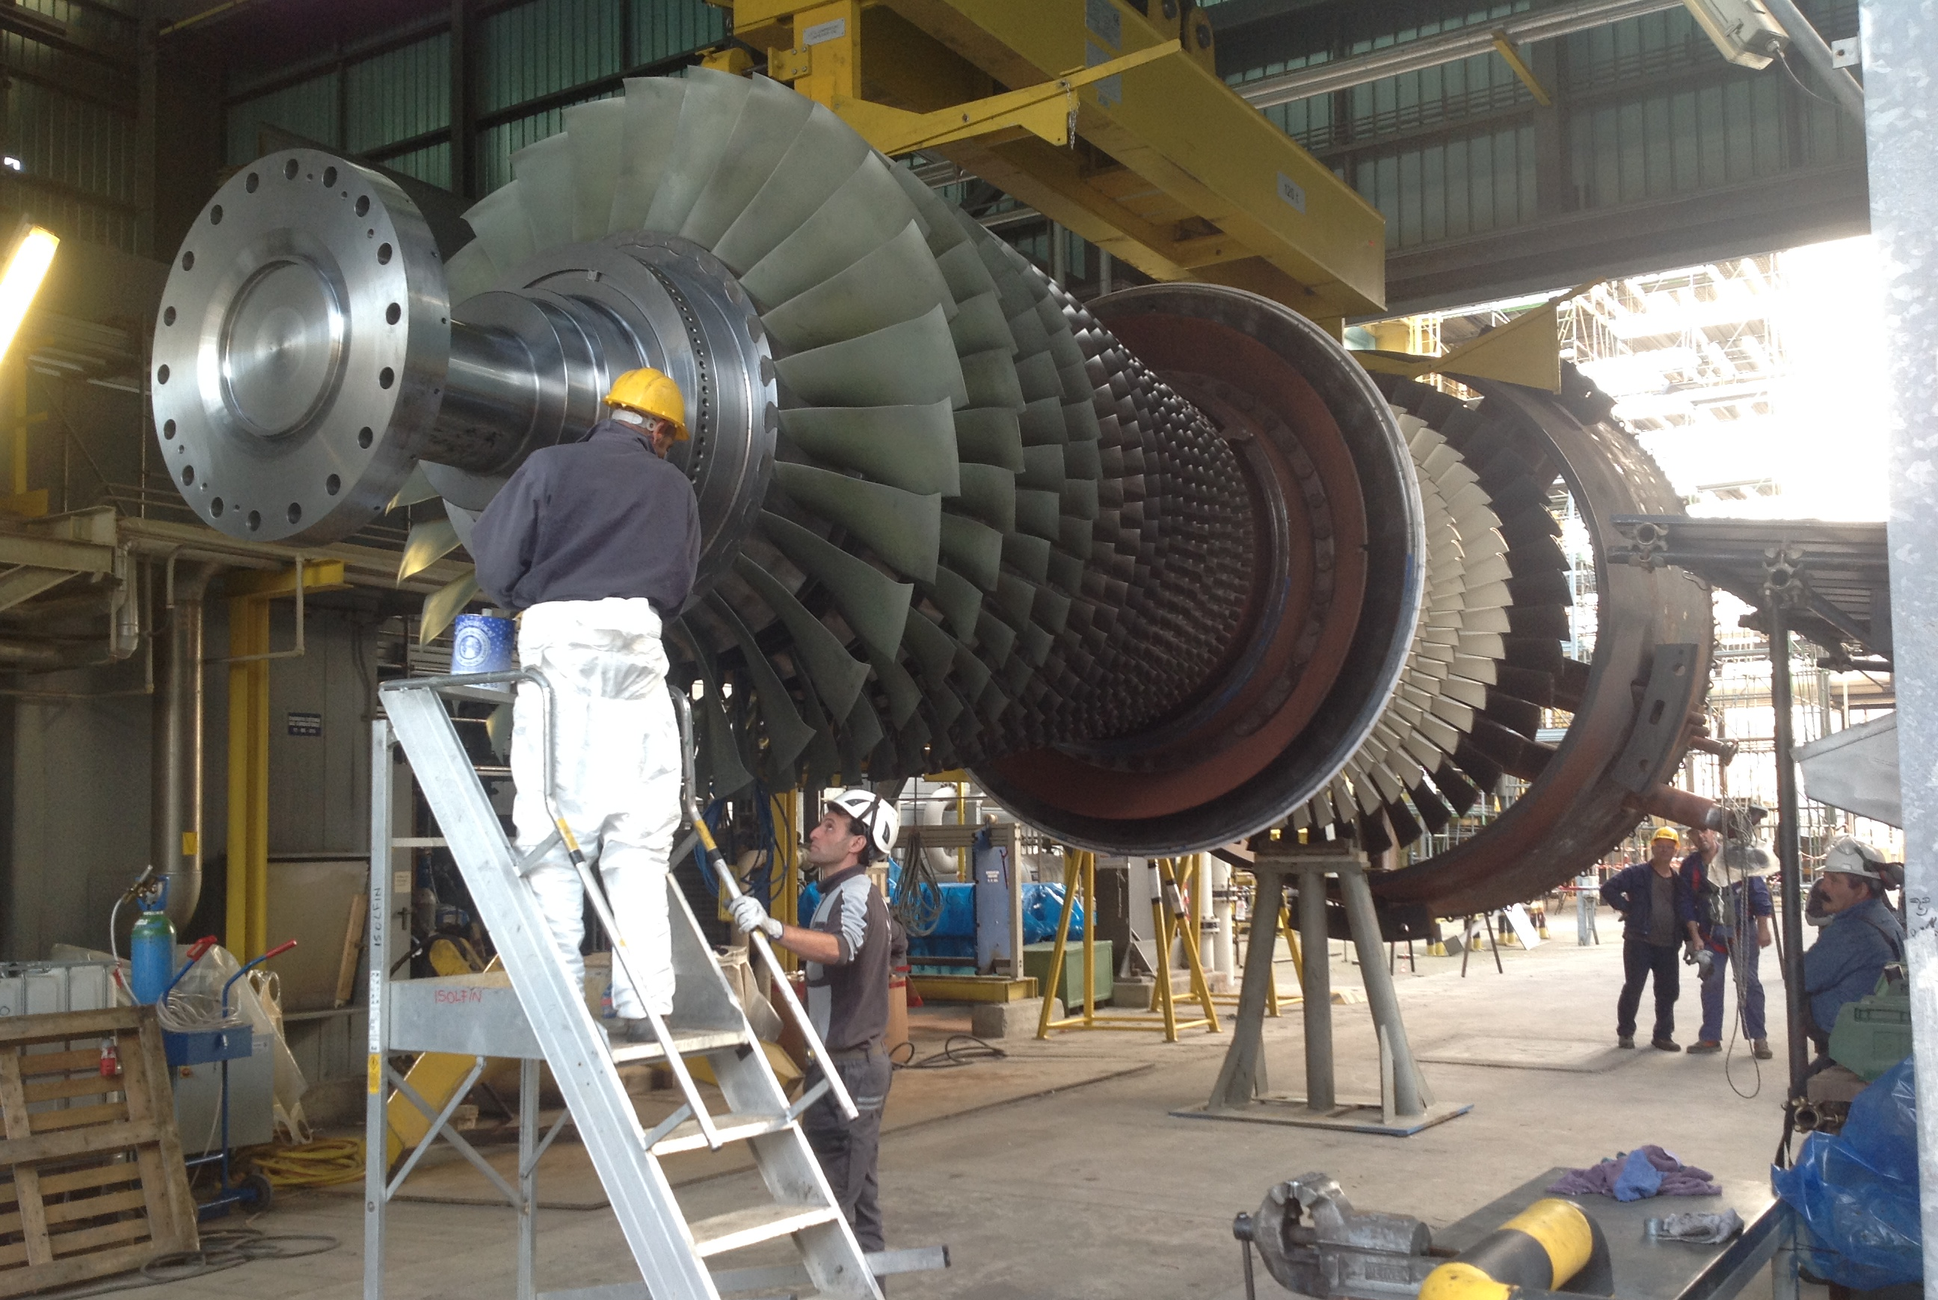
Courtesy of Ansaldo Energia
Notes:
Modal identification of rotor components is based on
Second issue is the force

Slide 4
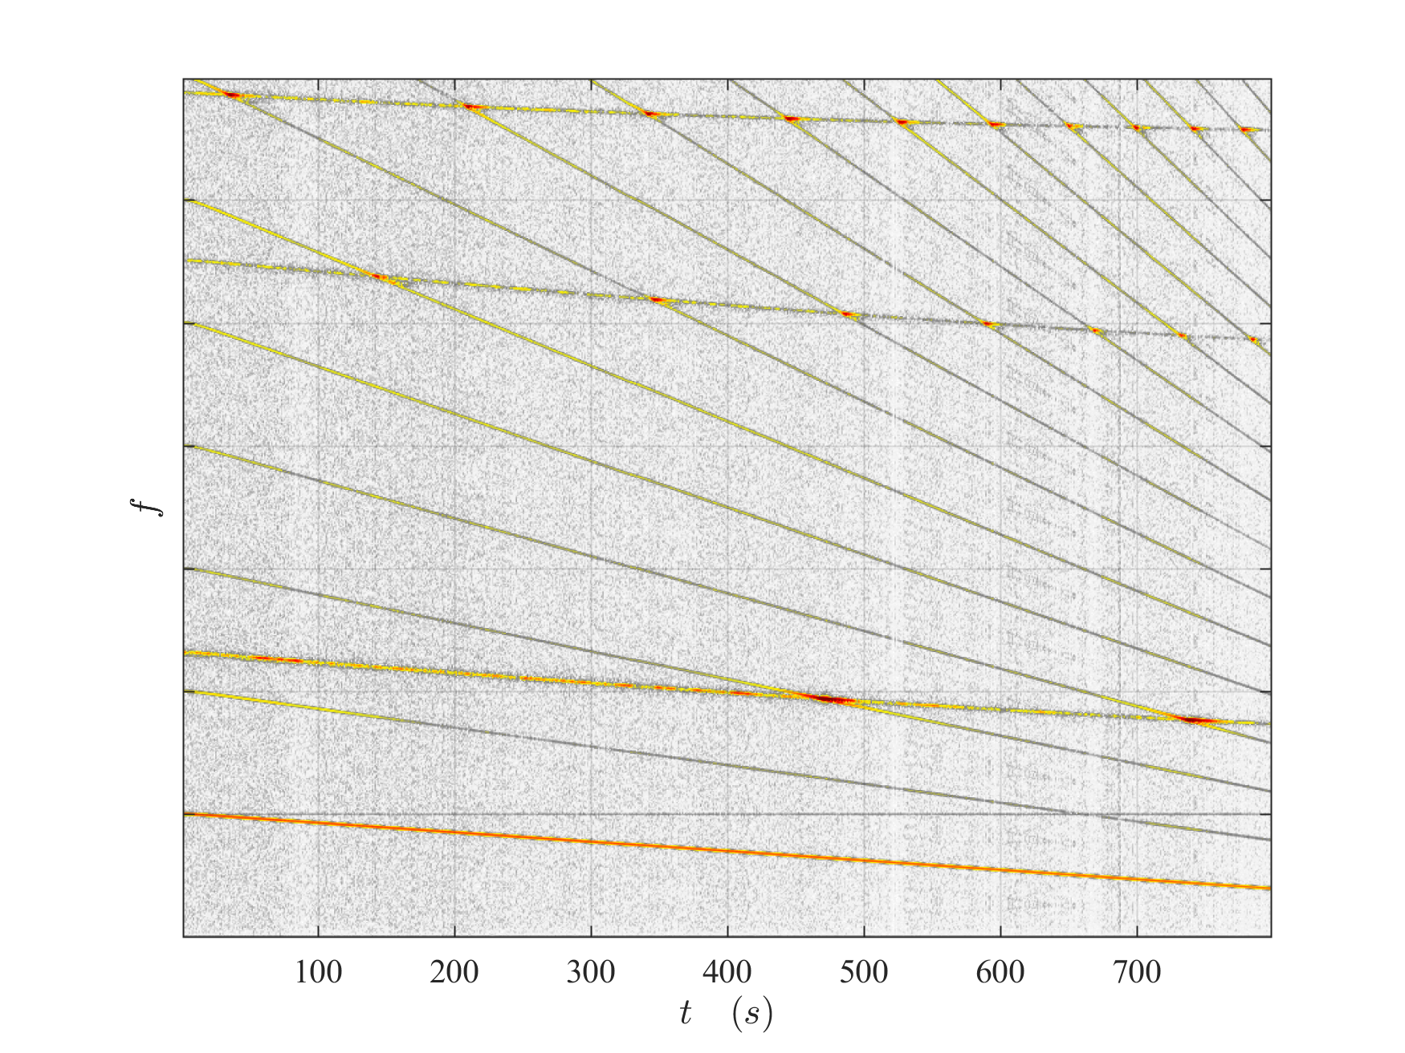
Resonance Crossing
Mode 3
Mode 2
Mode 1
4x
3x
2x
Rotor speed

Slide 5
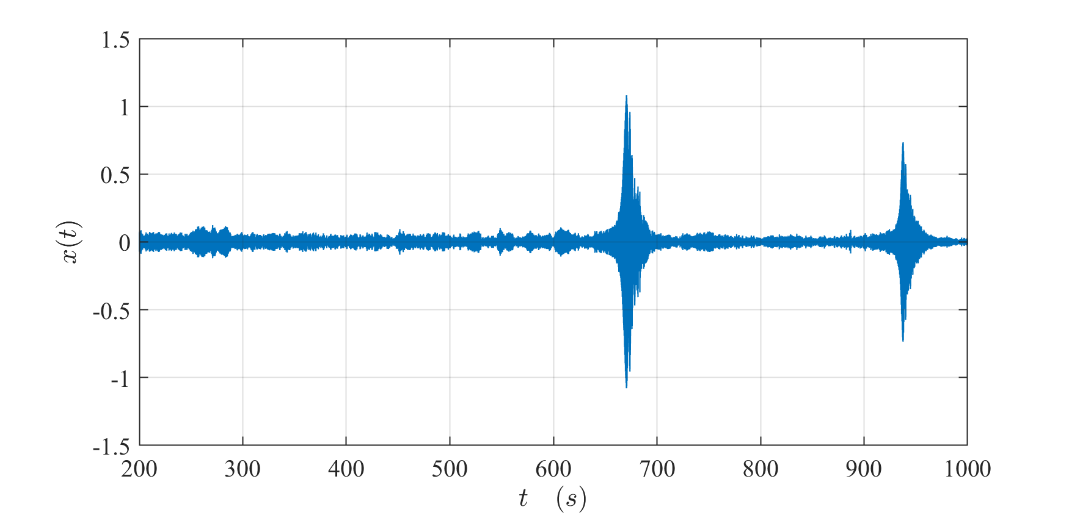

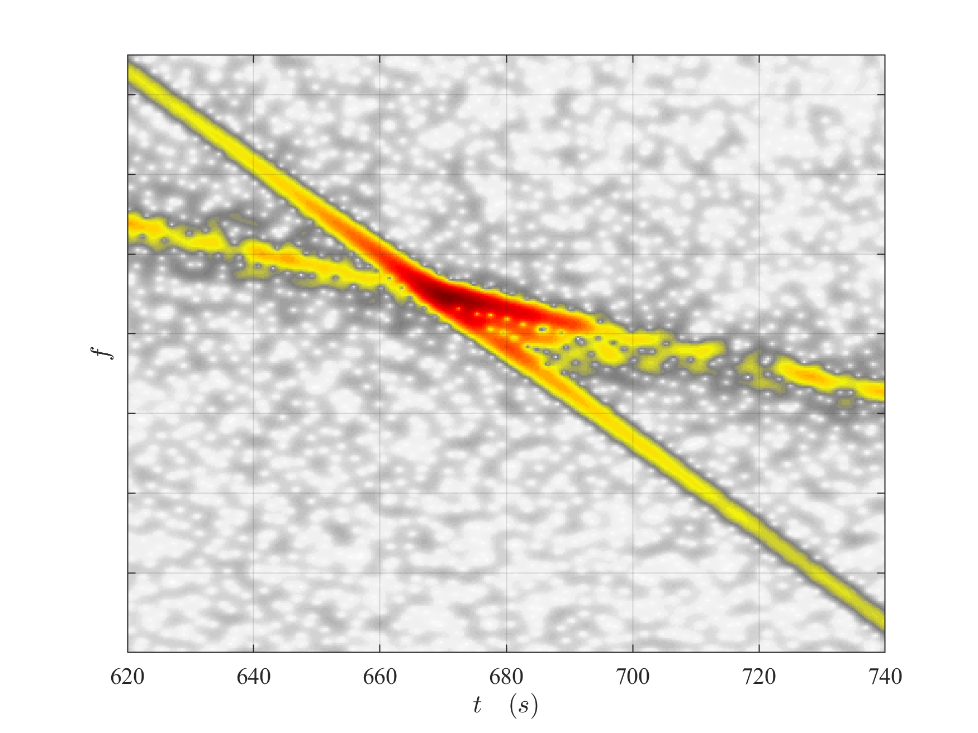
Resonance Crossing

Slide 6
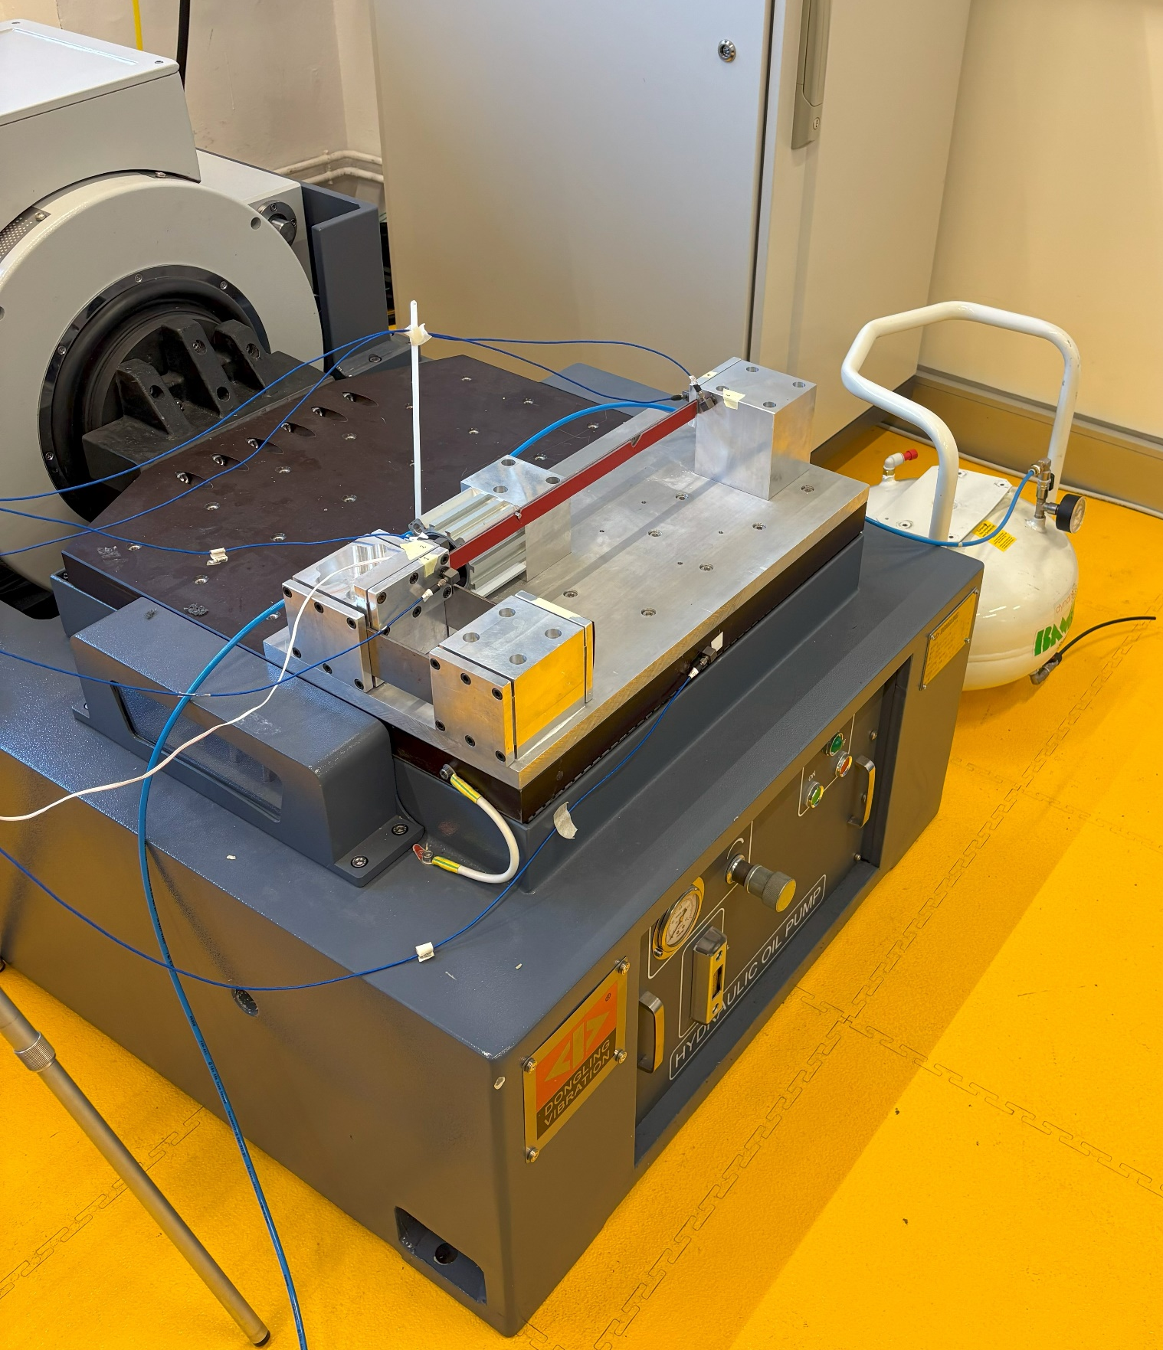
Experimental setup
Setup
Notes:
a thin still beam whose natural frequencies are modified by changing its axial load. One extremity of the beam is fixed to the frame, while the other end is fixed to an anchor block that only allows the axial component of the displacement. The axial load of the beam is controlled by a pneumatic cylinder. The pressure inside the pneumatic cylinder controlled by proportional regulator

Slide 7
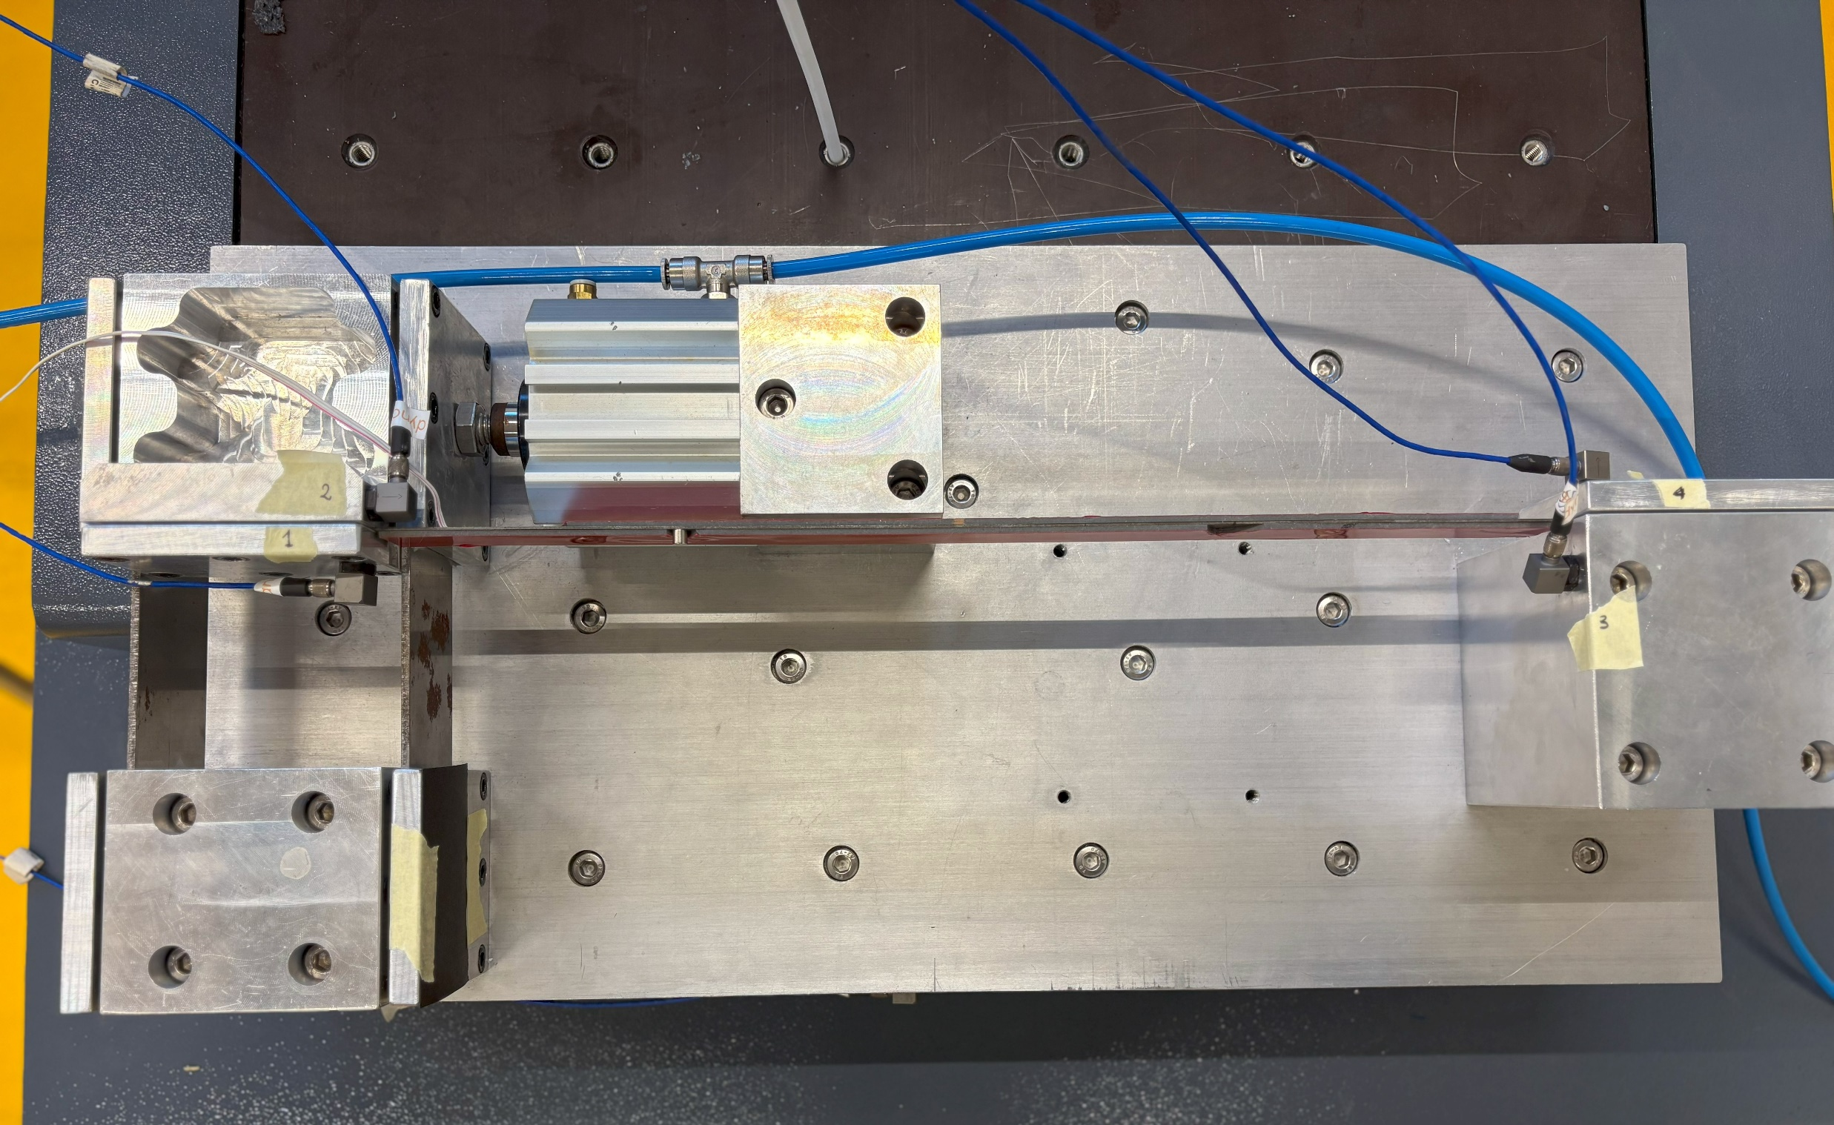
Experimental setup
Notes:
View from above
the second mode was analysed

Slide 8
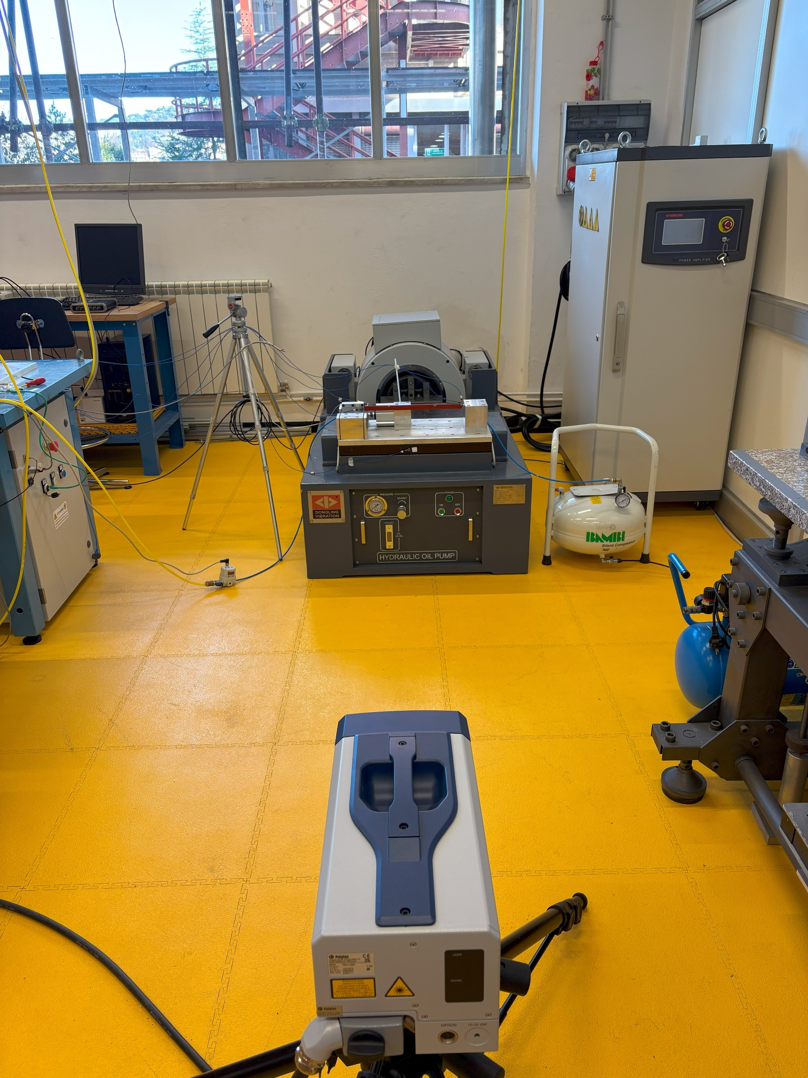
Experimental setup
Acquisition setup
Notes:
Vibrometer laser doppler

Slide 9
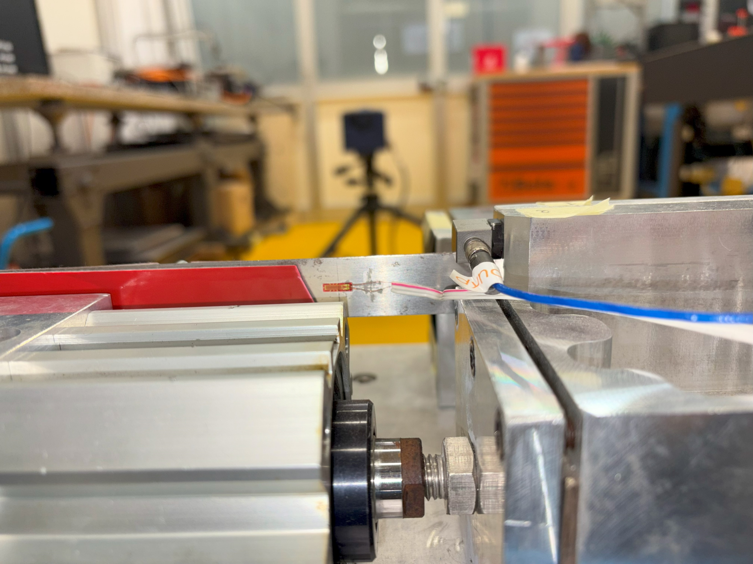
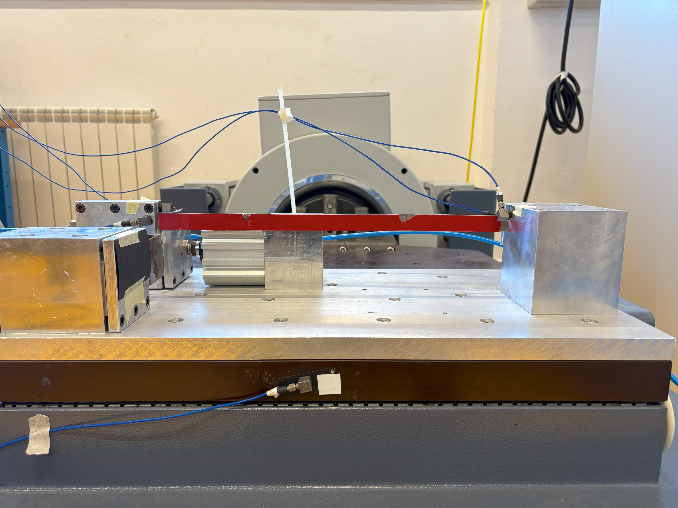
Experimental setup
Acquisition set up

Slide 10
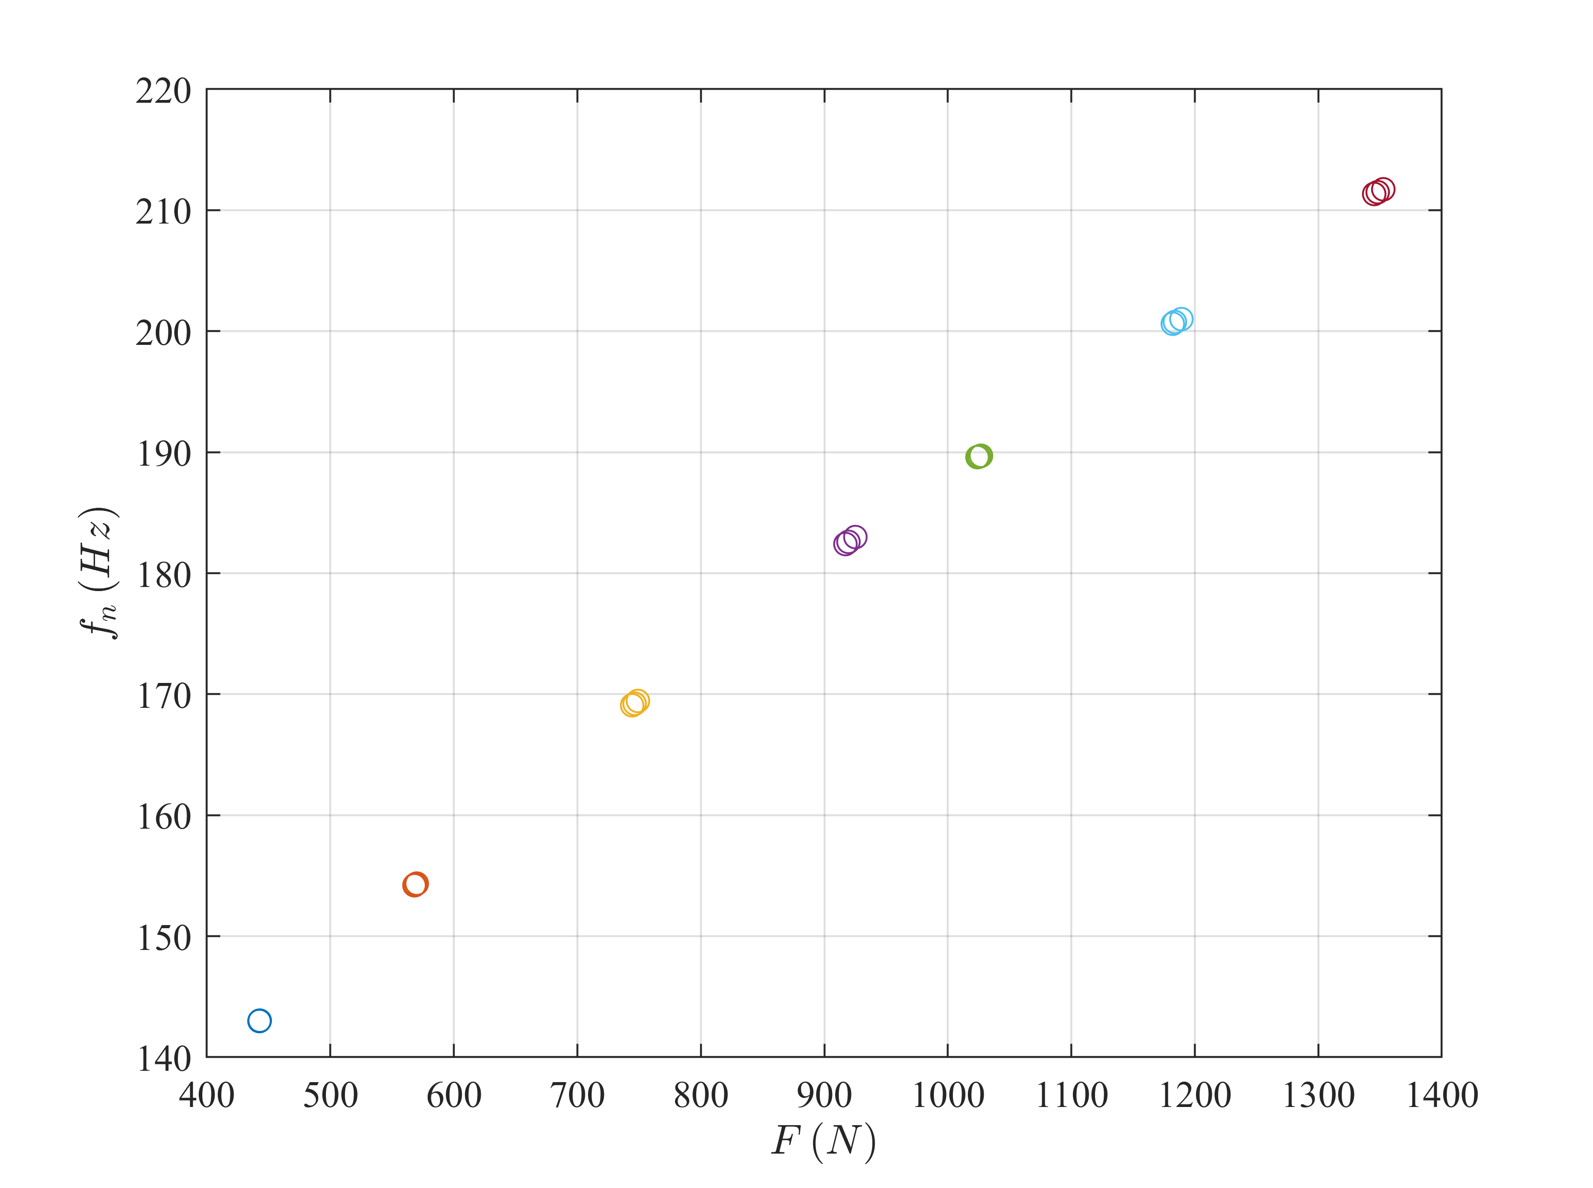
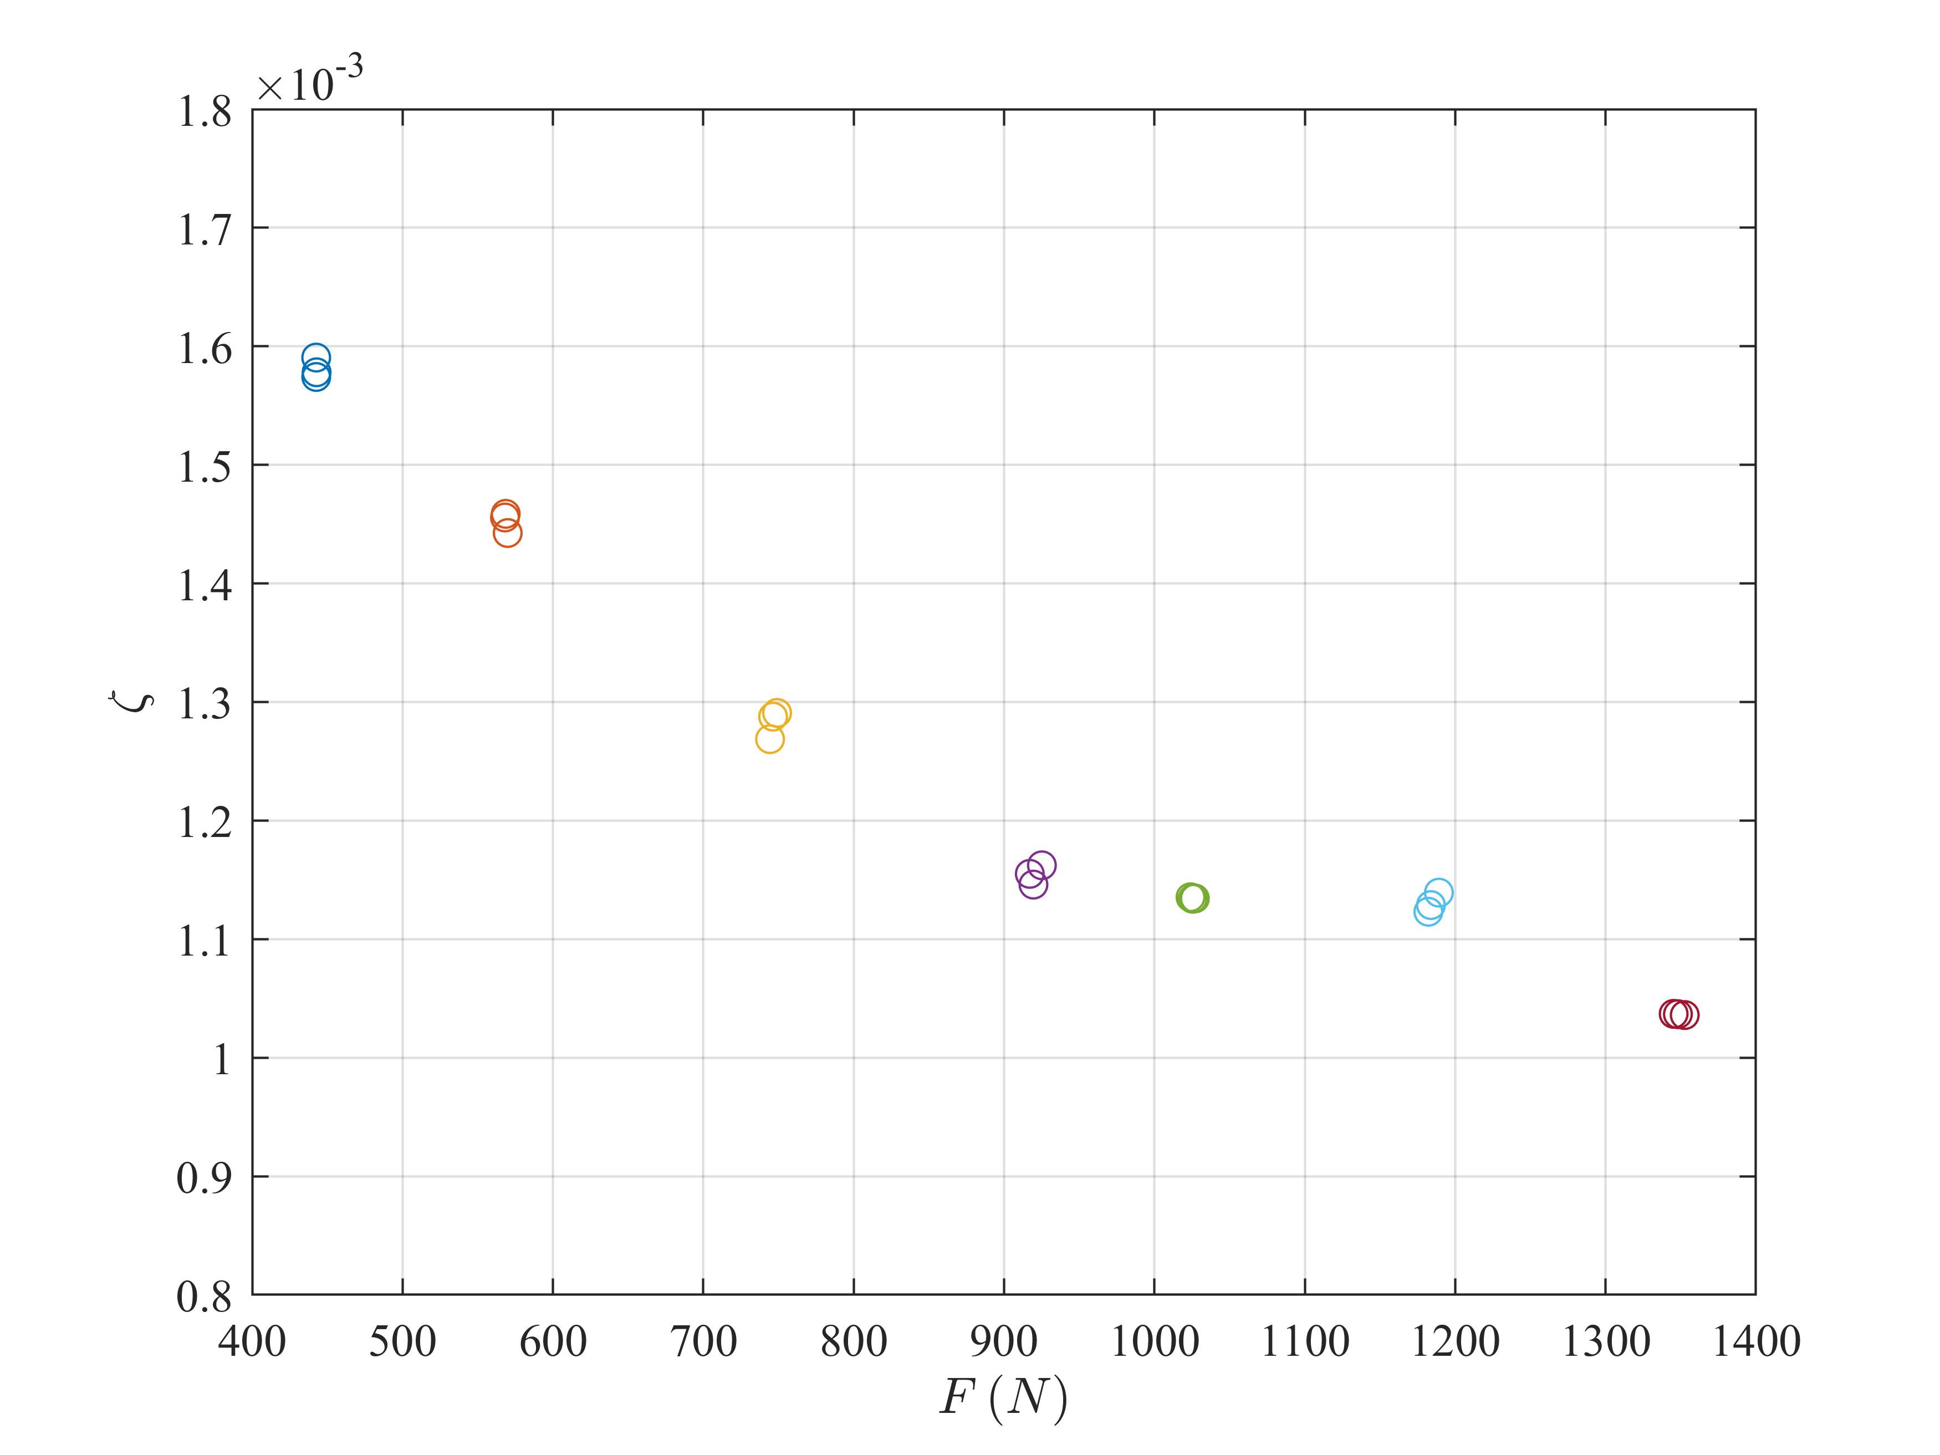
Static measure identification
Notes:
Different sweeps at fixed force are made

Slide 11
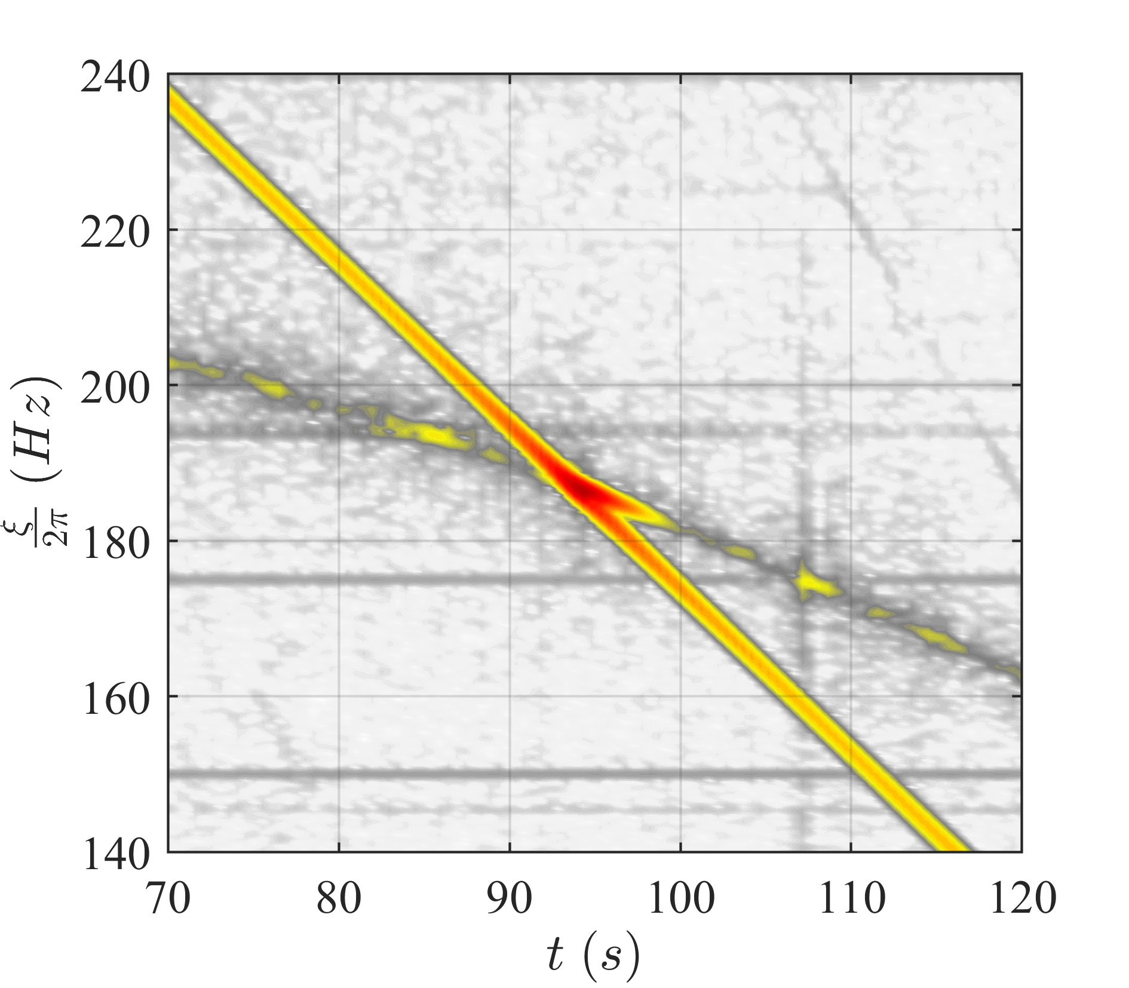
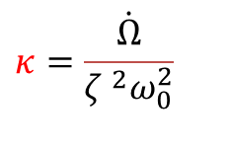
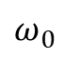
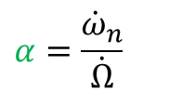
Tests
System parameters
Sweep rate:
$$κ=\frac{\dot{Ω}}{ζ ^{2}ω_{0}^{2}}$$
$$ω_{0}$$
Natural frequency slope :
$$α=\frac{{\dot{ω}}_{n}}{\dot{Ω}}$$

Slide 12
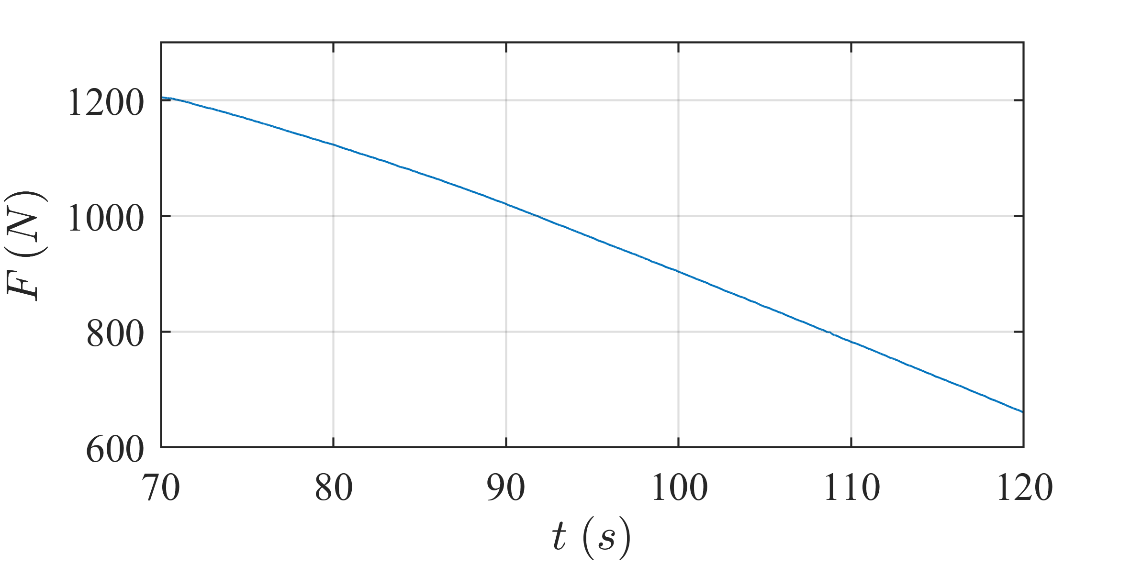
Tests
$$κ=10$$

Slide 13
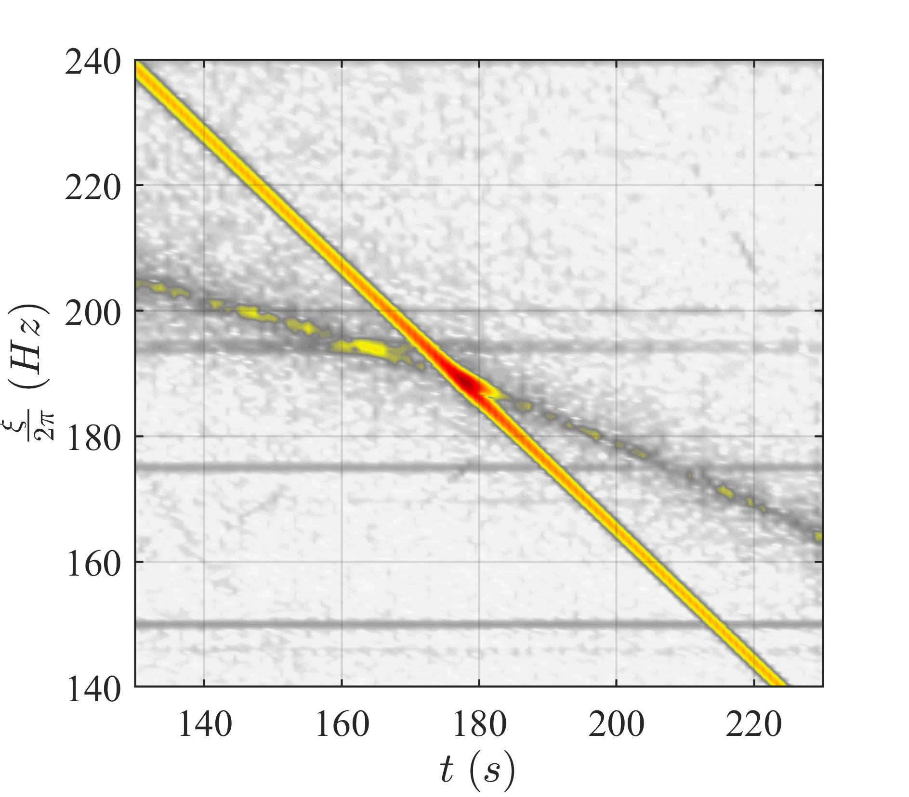
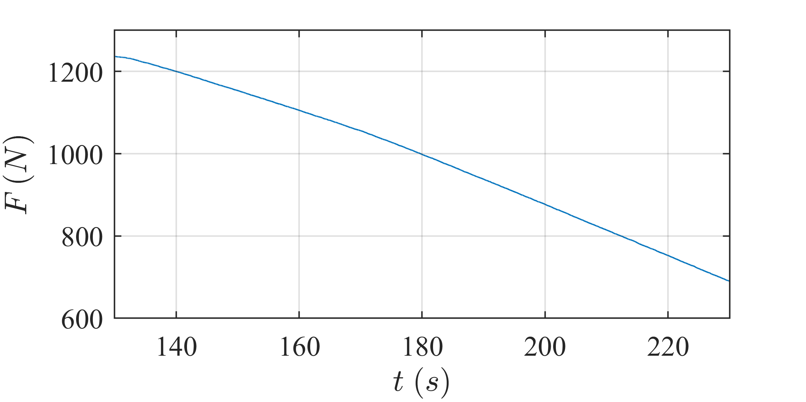
Tests
$$κ=5$$

Slide 14
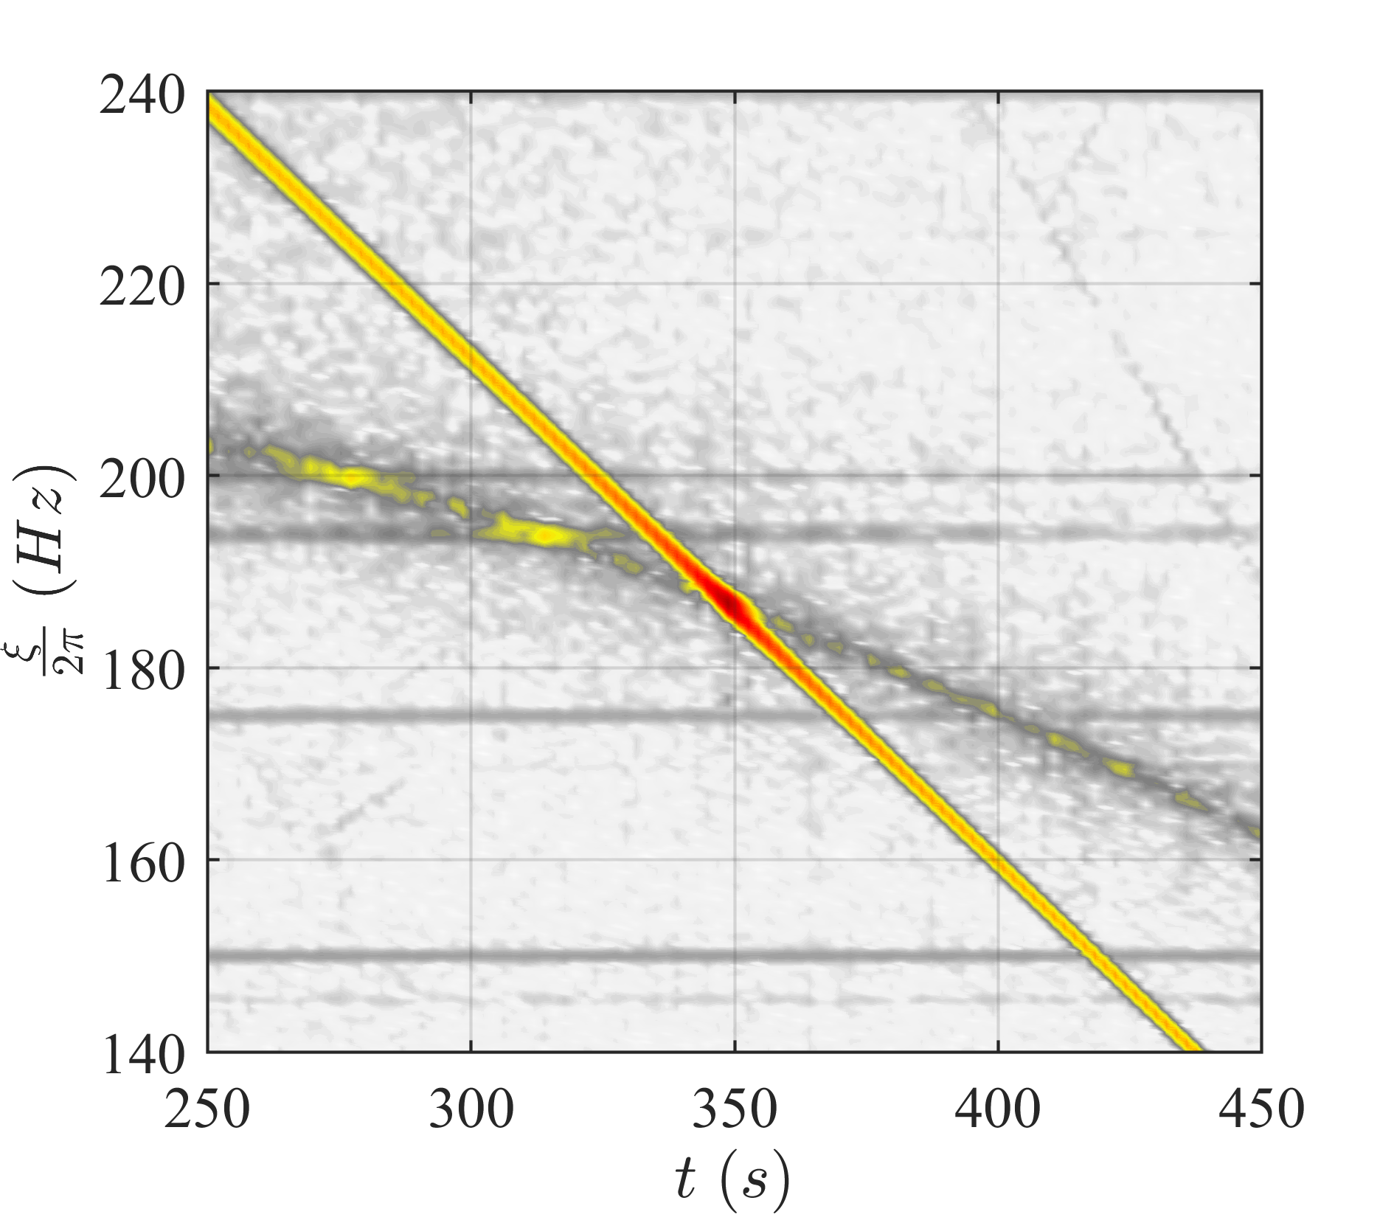
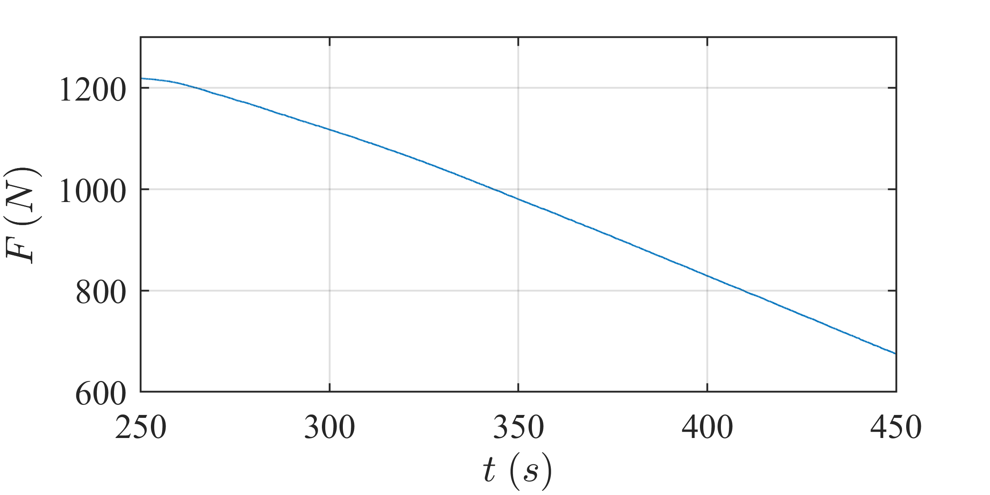
Tests
$$κ=2,5$$
Notes:
Because this is a wavelet spectrogram, and we analyse wavelet based FRF

Slide 15
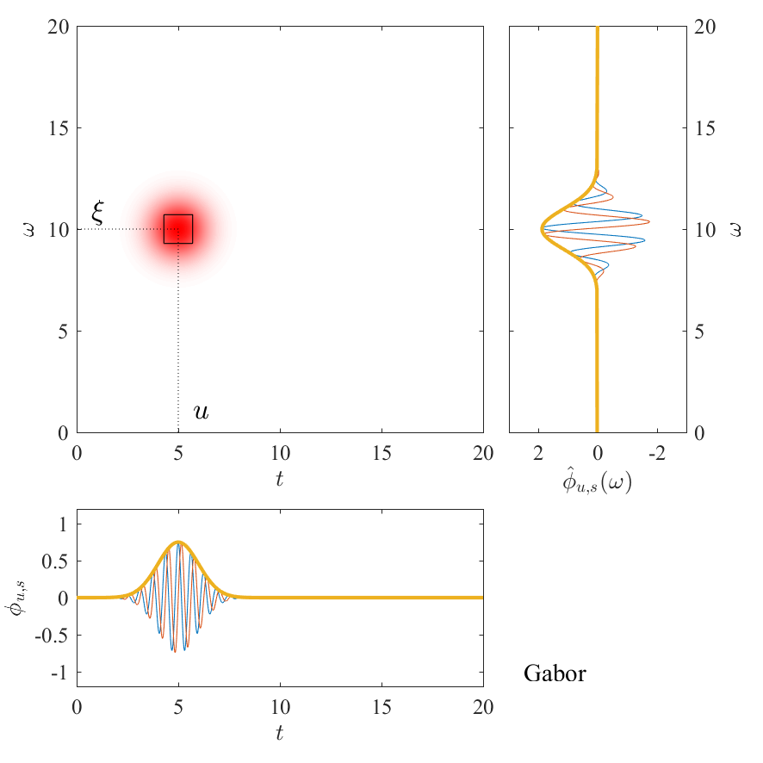
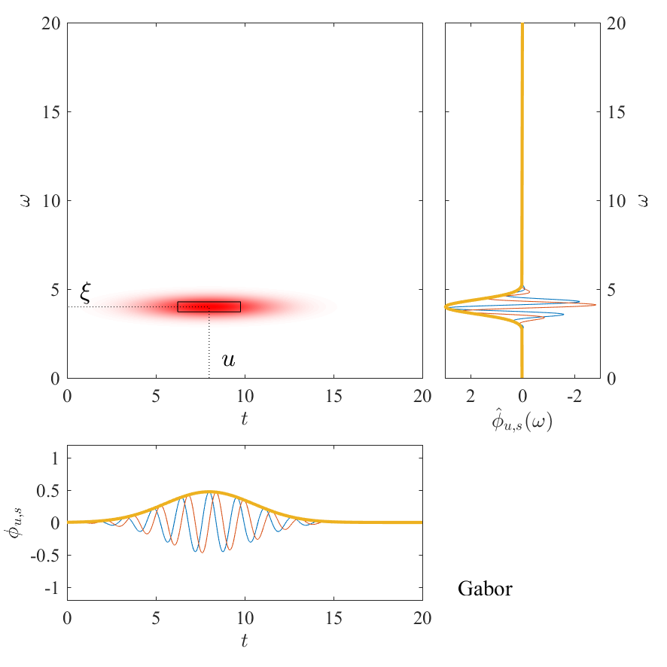
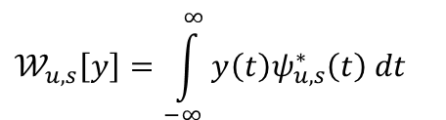
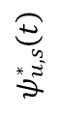
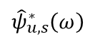
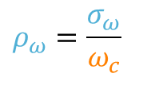
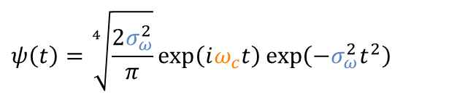
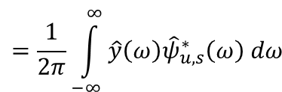
Wavelet Transform
Definition
$$𝒲_{u,s}\left[y\right]=\int_{−∞}^{∞}{y\left(t\right)ψ_{u,s}^{∗}​\left(t\right) dt}$$
$$=\frac{1}{2π}\int_{−∞}^{∞}{\hat{y}\left(ω\right){\hat{ψ}}_{u,s}^{∗}​\left(ω\right) dω}$$
Gabor wavelet
$$ψ\left(t\right)=\sqrt[4]{\frac{2σ_{ω}^{2}}{π}}\exp\left(iω_{c}t\right)\exp\left(−σ_{ω}^{2}t^{2}\right)$$
$${\hat{ψ}}_{u,s}^{∗}​\left(ω\right)$$
Relative frequency spread
$$ρ_{ω}=\frac{σ_{ω}}{ω_{c}}$$
$$ψ_{u,s}^{∗}​\left(t\right)​$$
Notes:
correlation between the signal itself and a set of functions called wavelets, parameterized by the central time 𝑢 and the scale 𝑠 . The WT represents the complex amplitude of the signal at a specific time 𝑢 and for a specific frequency 𝜉. This information, however, is not perfectly localized and may be regarded as an average within a region of the time-frequency plane centered in 𝑢, 𝜉
HB and HUP

Slide 16
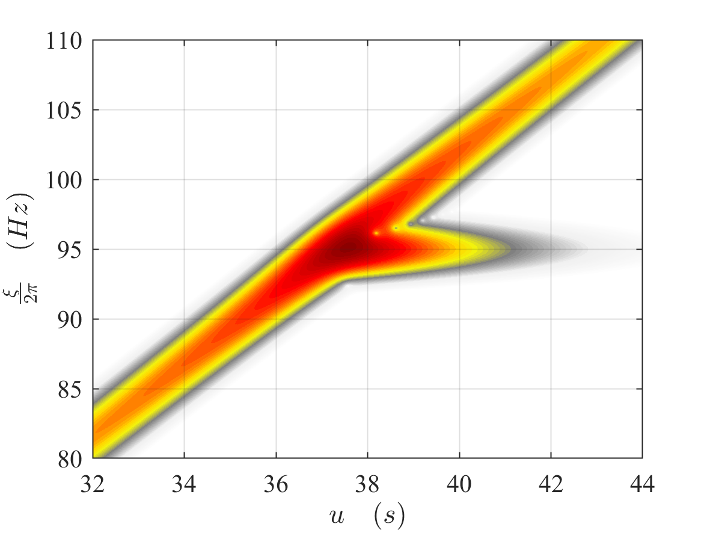
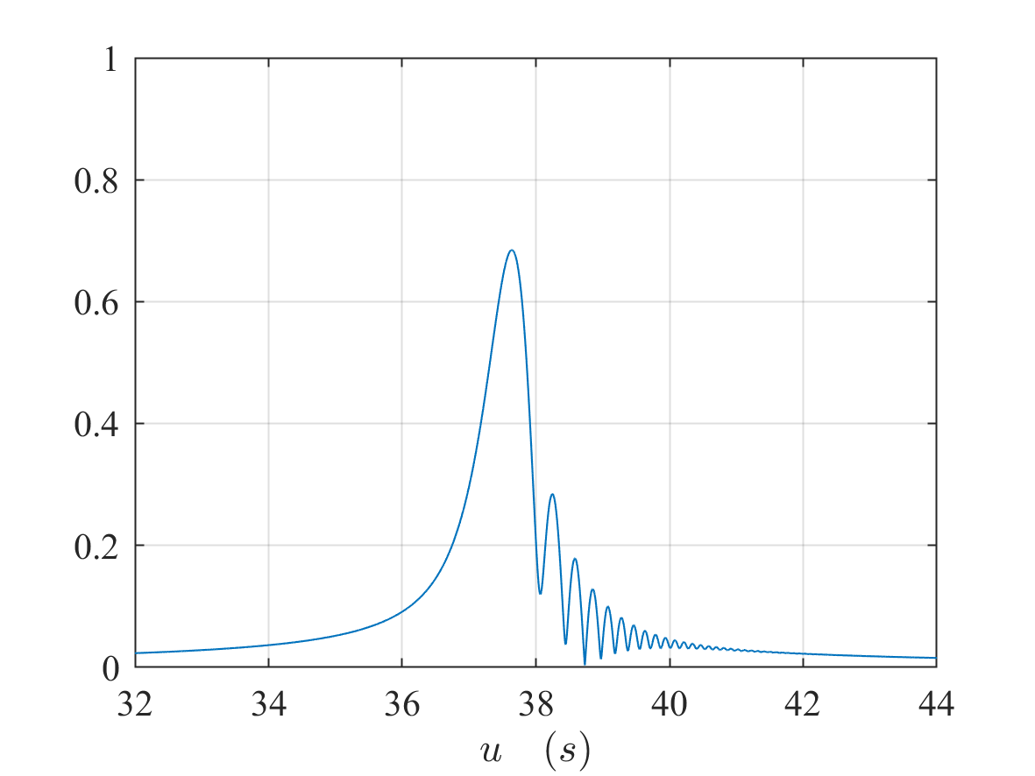
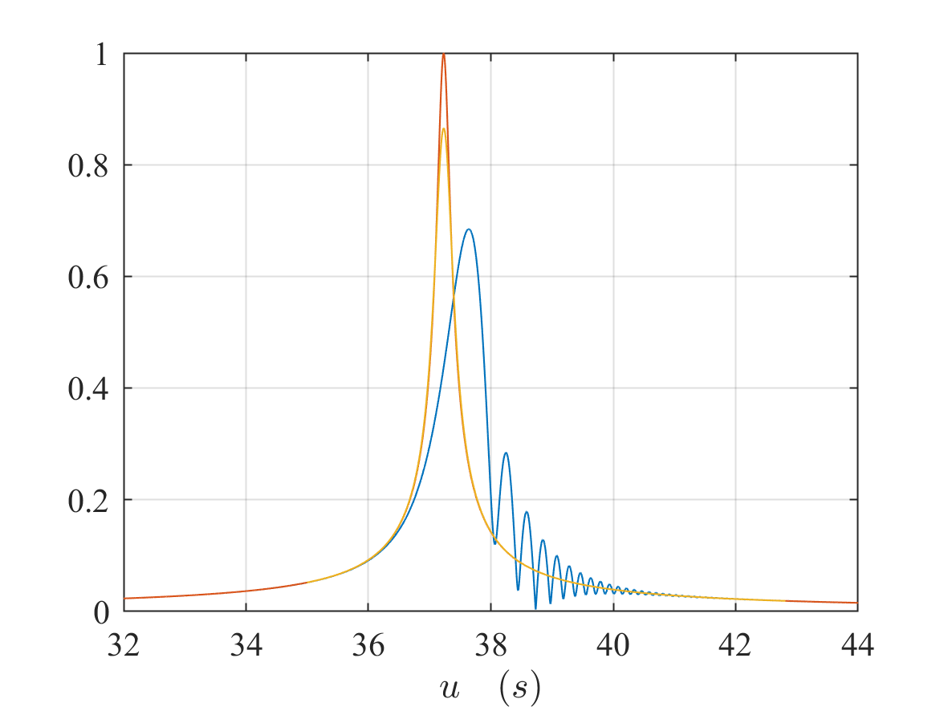
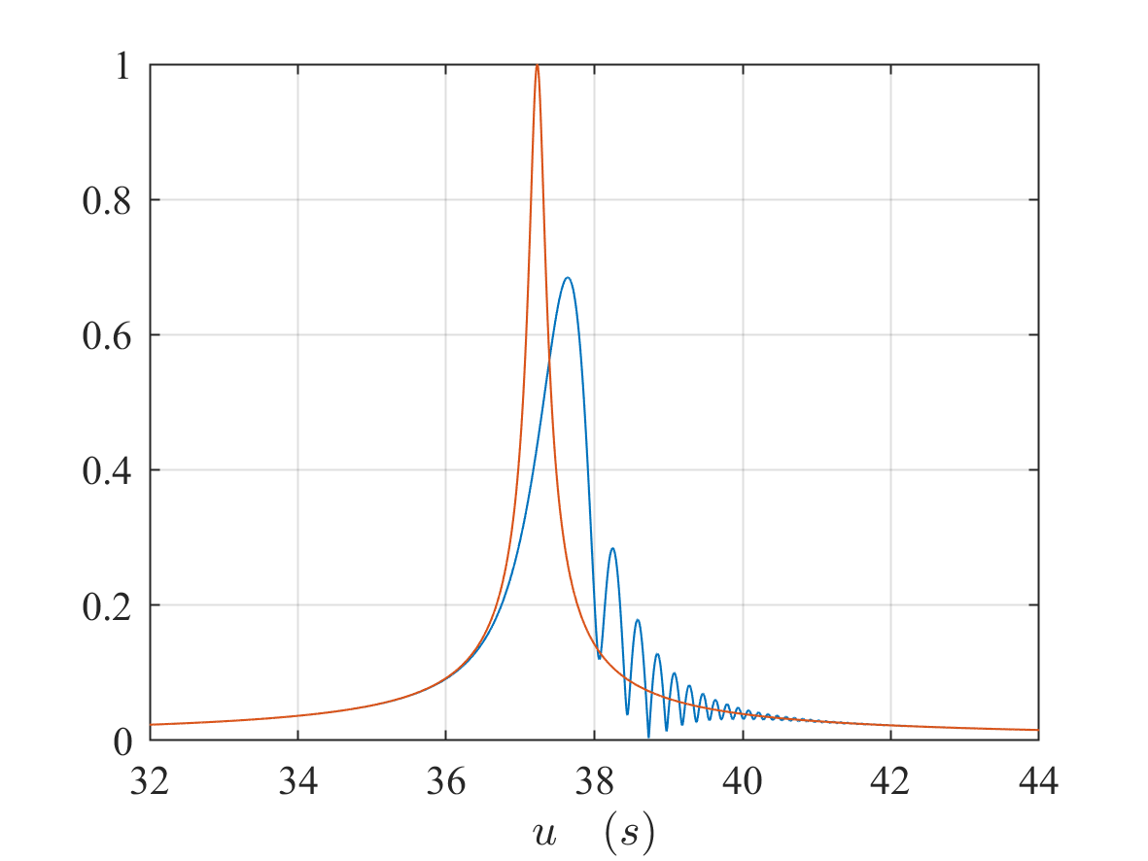
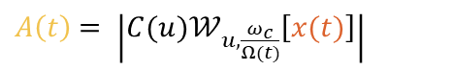
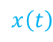
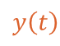
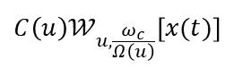
Wavelet probing
$$x\left(t\right)$$
Measured response
$$y\left(t\right)$$
Synchronous response
$A\left(t\right)$ $= \left|C(u)𝒲_{u,\frac{ω_{c}}{Ω(t)}}\left[x(t)\right]\right|$
Amplitude estimated by WP
$$C\left(u\right)𝒲_{u,\frac{ω_{c}}{Ω\left(u\right)}}\left[x(t)\right]$$
Synchro response
Full response
Notes:
Wp is a technique to estimate the synchronous response in resonance crossing situation computing the wavelet transfrom along the EO line

Slide 17
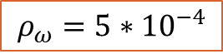
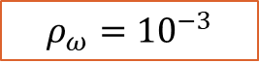
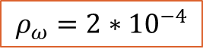
Wavelet probing
Dependency of $ρ_{ω}$
$$ρ_{ω}={10}^{−3}$$
$$ρ_{ω}={5∗10}^{−4}$$
$$ρ_{ω}={2∗10}^{−4}$$
Notes:
Good estimation even if the peak is narrow and sharp due to the low value of the damping. Now it is known that

Slide 18
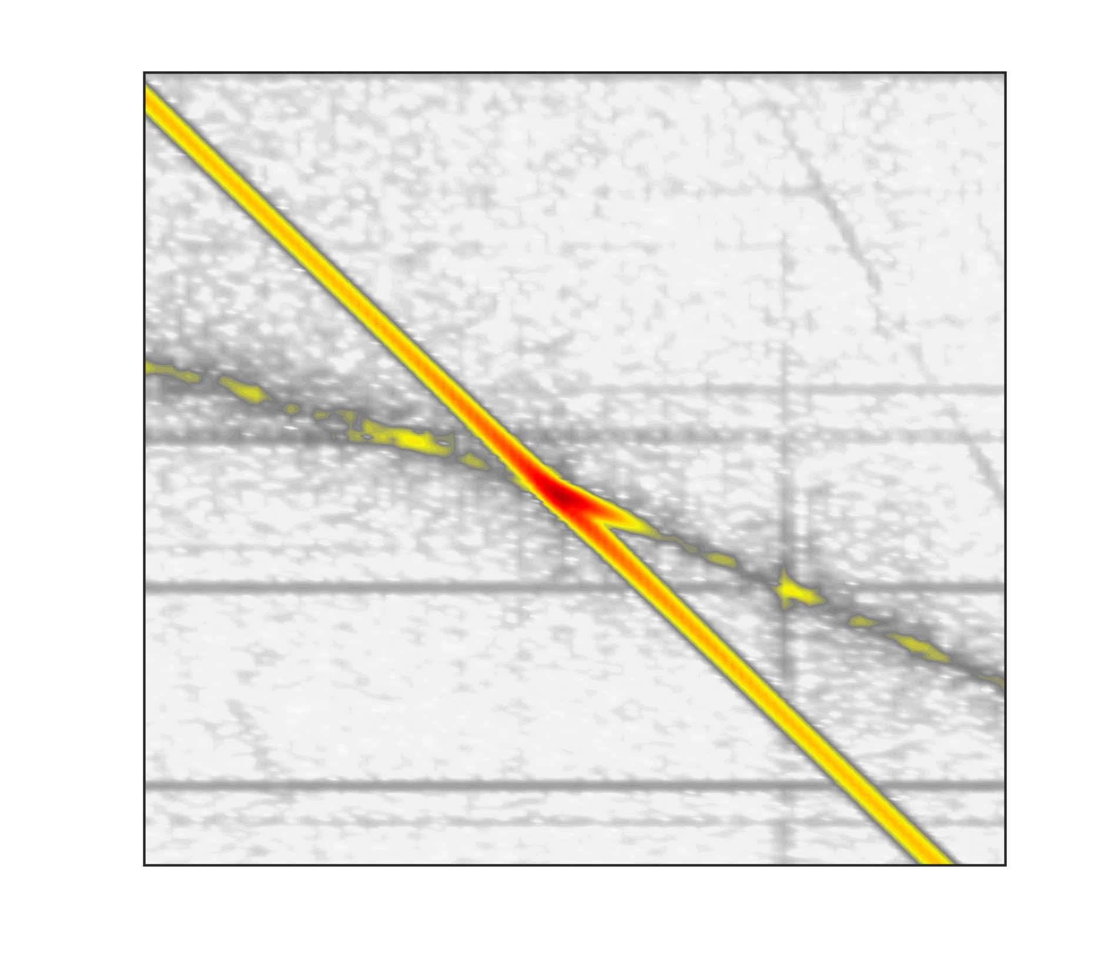
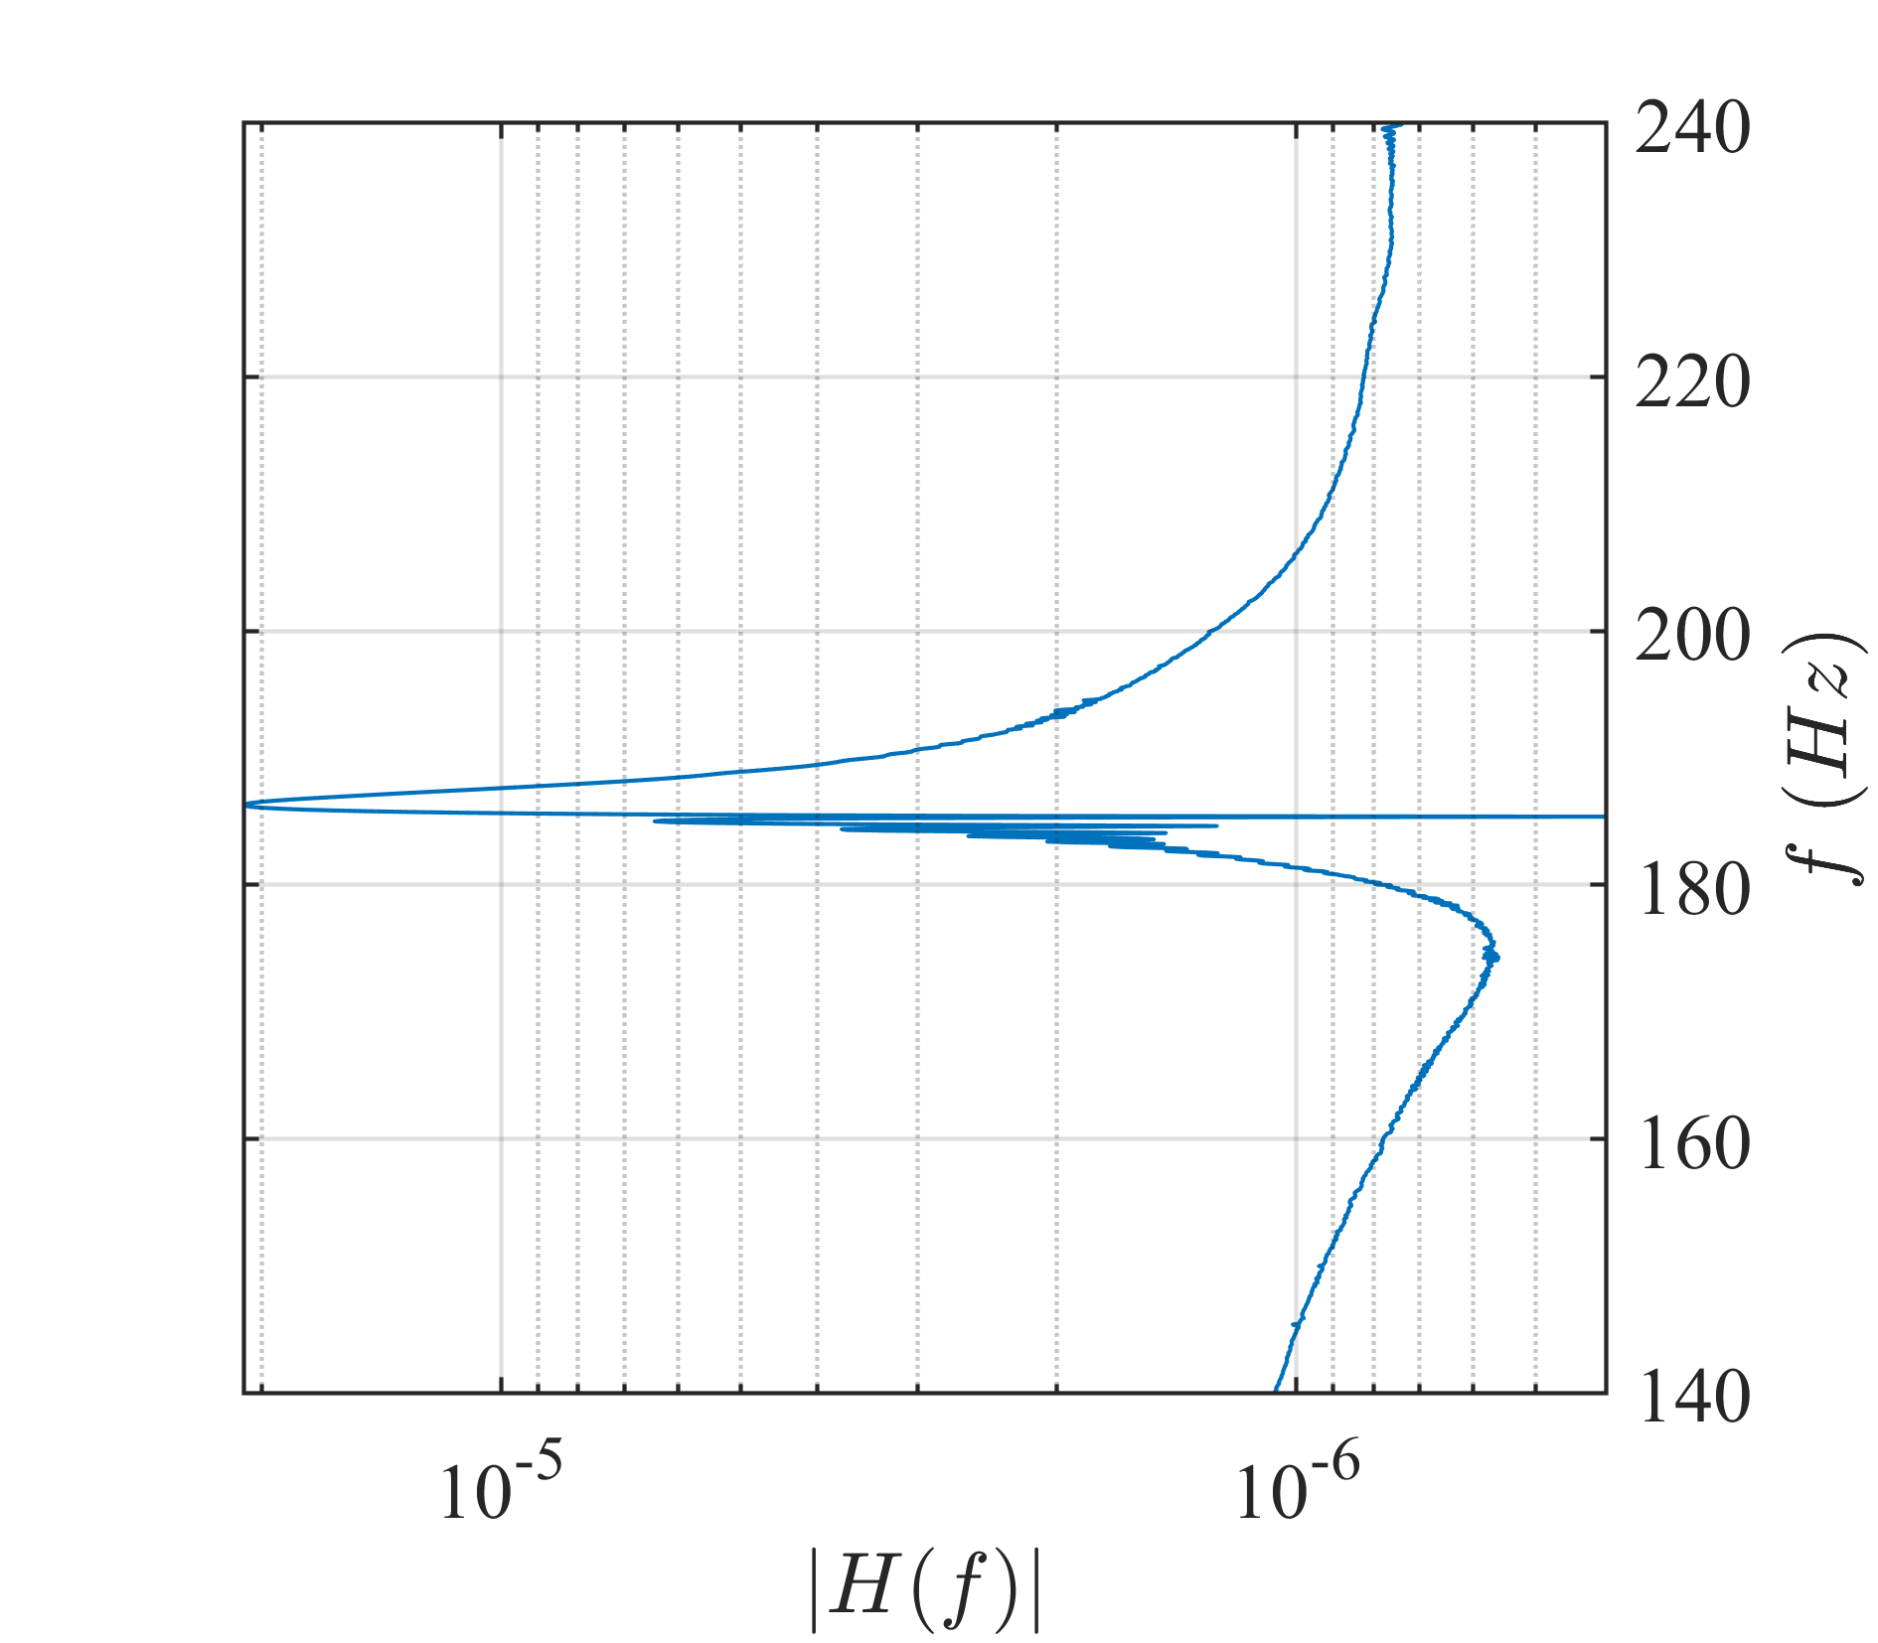
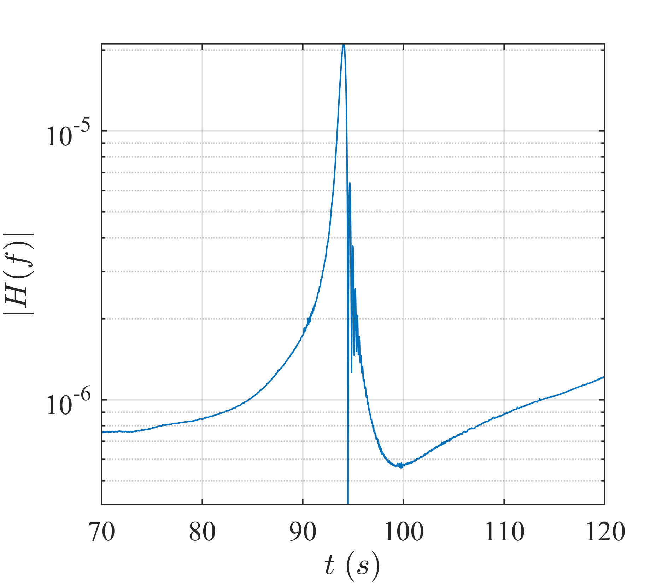
Motivation
LTV
Notes:
A solution could be

Slide 19
Proposed approaches
1. Probing with a “rotated” wavelet
Iaffaldano, D, Guida, R, & Carassale, L.(2024) "Synchronous Response of Rotor Components by Rotated Wavelet Probing." Proceedings of the ASME Turbo Expo 2024. Volume 10B.
2. Exploit equivalence between LTV and LTI
Carassale, L., Denoël, V. (2023). “A time-variant/invariant equivalence for transient response of rotor blades in resonance.” IMAC-XLI.

Slide 20
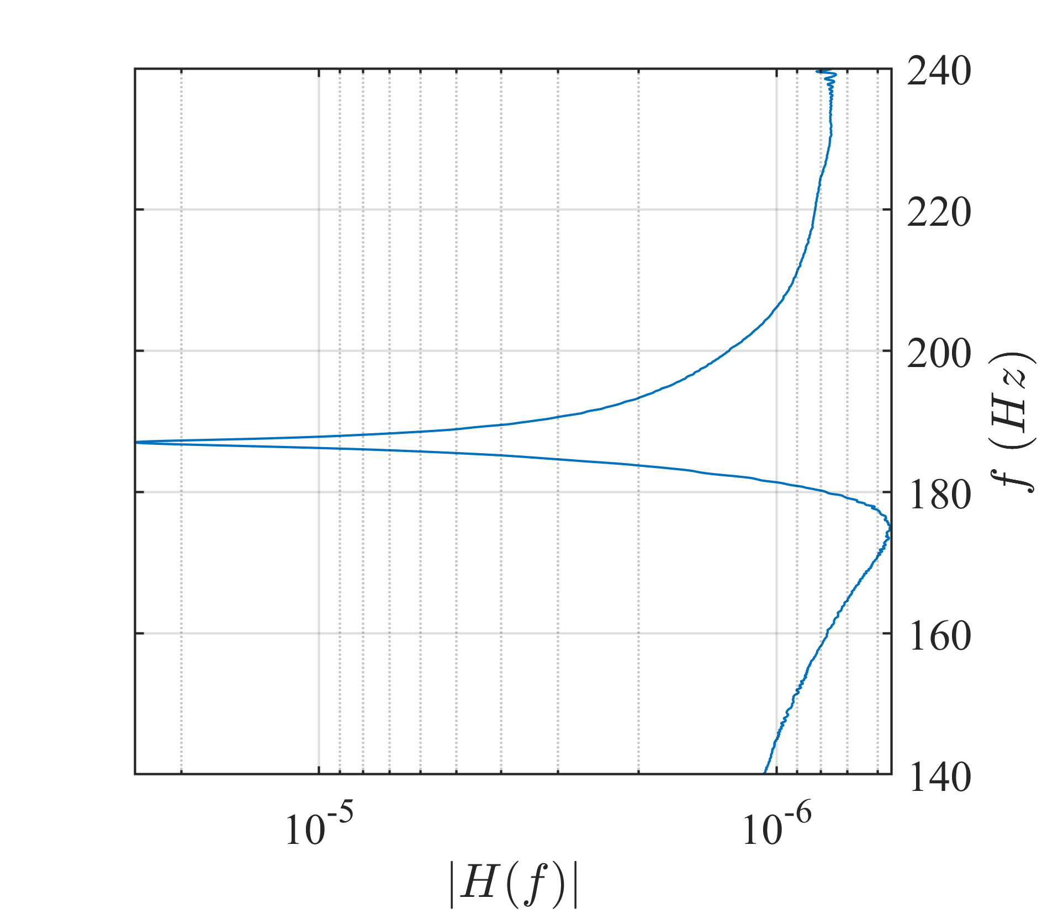
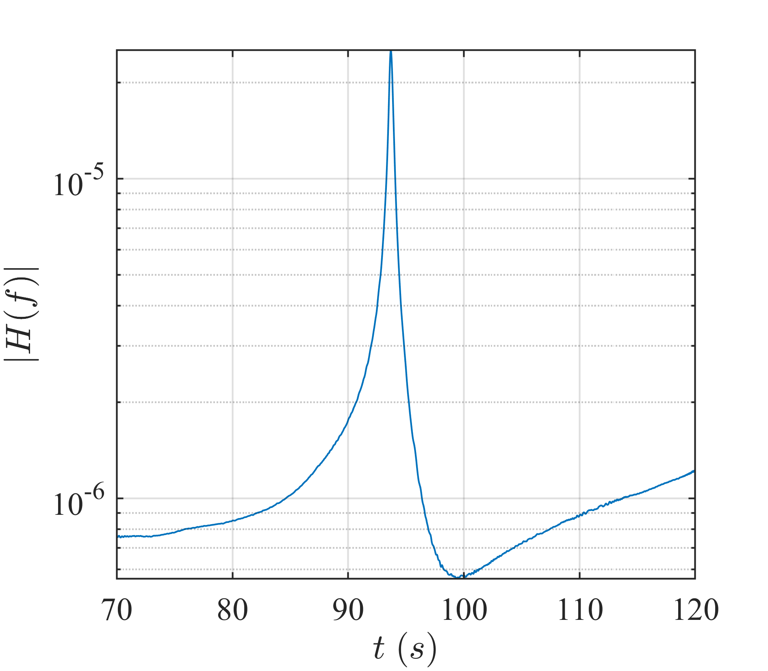
Rotated wavelet
Notes:
A solution could be

Slide 21
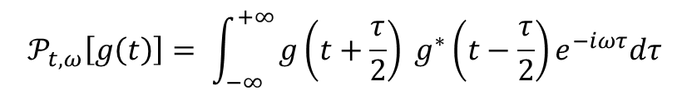
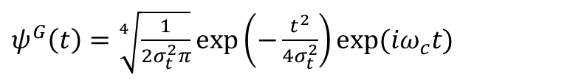
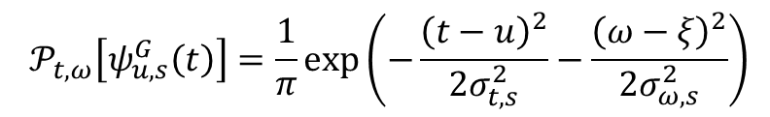
Parametrization of the rotated wavelet
The Wigner-Ville distribution for a complex signal $g\left(t\right)$:
$${ 𝒫}_{t,ω}\left[g\left(t\right)\right]= \int_{−∞}^{+∞}{g\left(t+\frac{τ}{2}\right) g^{∗}\left(t−\frac{τ}{2}\right)e^{−iωτ}dτ}$$
For Gabor wavelet :
$ψ^{G}\left(t\right)=\sqrt[4]{\frac{1}{2σ_{t}^{2}π}}\exp\left(−\frac{t^{2}}{4σ_{t}^{2}}\right)exp⁡(iω_{c}t)$
$${ 𝒫}_{t,ω}\left[ψ_{u,s}^{G}\left(t\right)\right]=\frac{1}{π}\exp\left(−\frac{{\left(t−u\right)}^{2}}{2σ_{t,s}^{2}}−\frac{{\left(ω−ξ\right)}^{2}}{2σ_{ω,s}^{2}}\right)$$
Notes:
To analyzed the shape of HB, I need to introduce a mathematical tool call

Slide 22
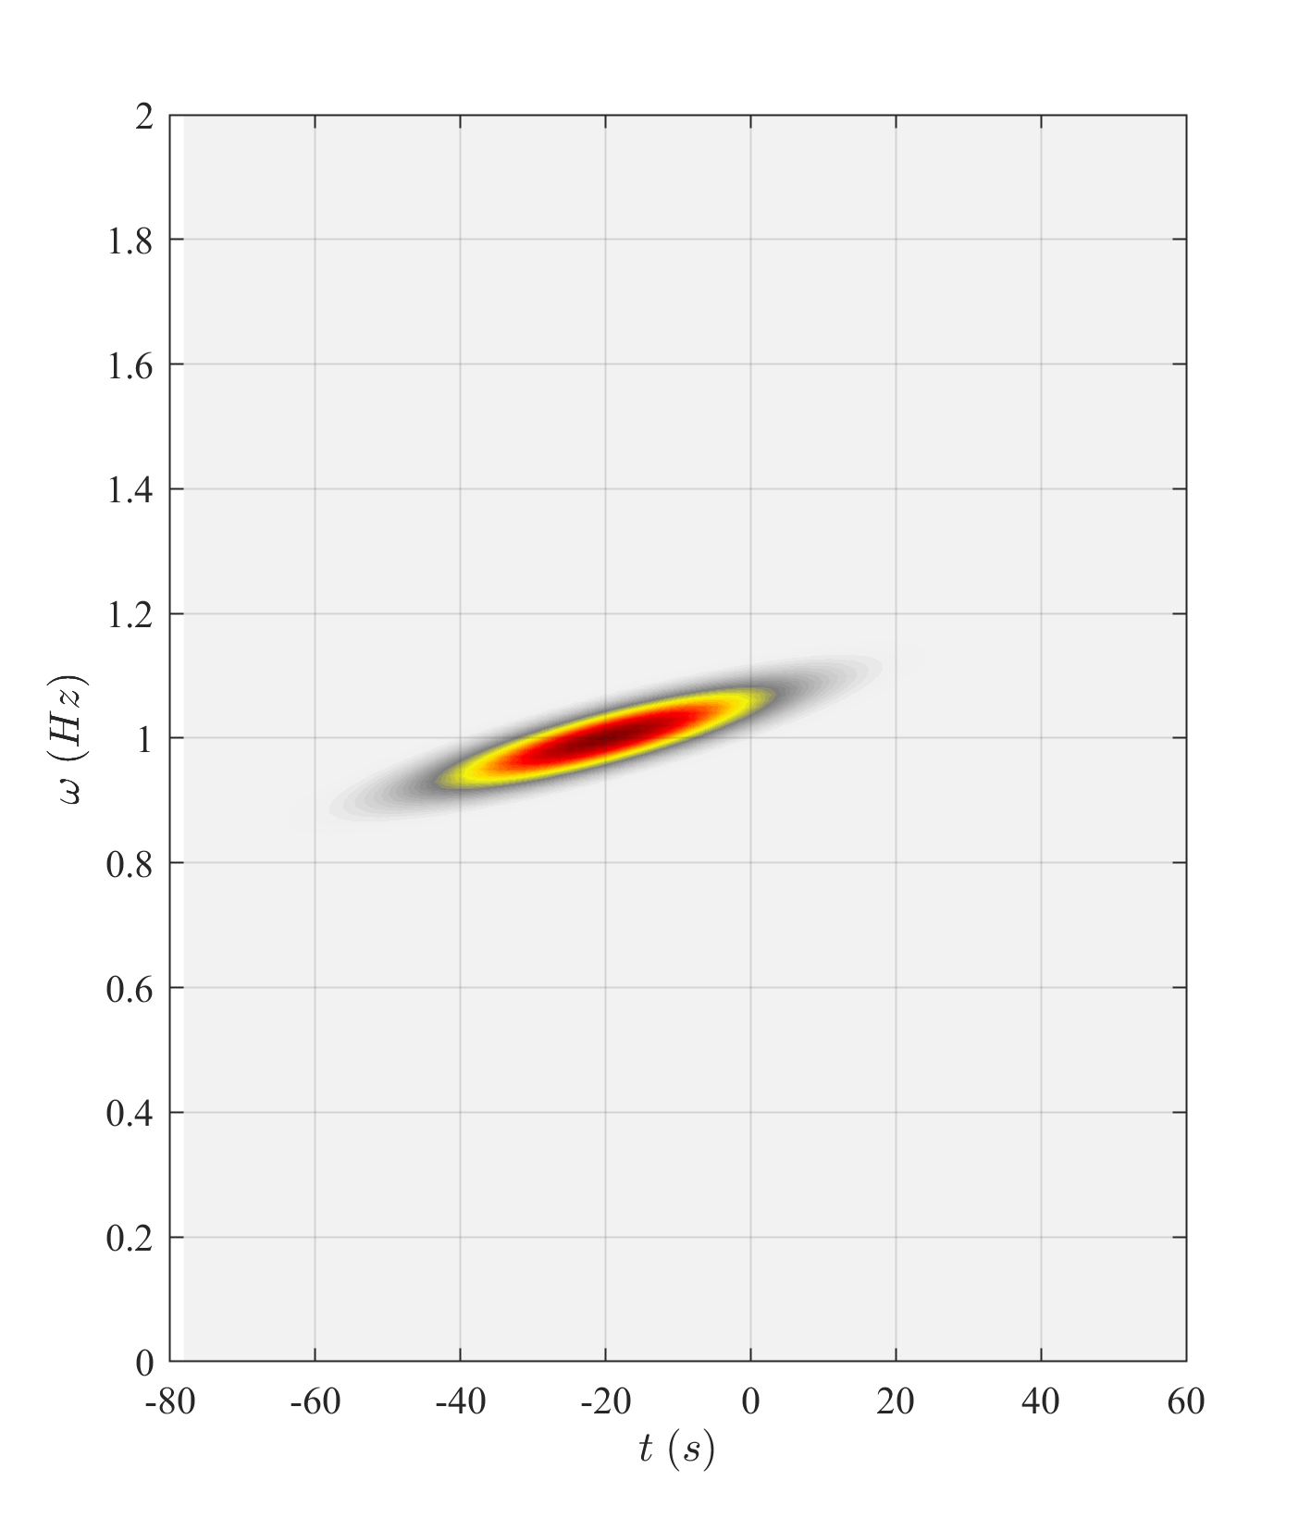
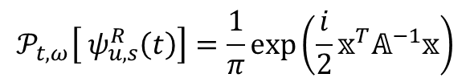





Proposed methods for LTV identification
Rotated Gabor wavelet
$$𝒫_{t,ω}\left[ ψ_{u,s}^{R}\left(t\right)\right]=\frac{1}{π}\exp\left(\frac{i}{2}𝕩^{T}𝔸^{−1}𝕩\right)$$
$$θ$$
$$𝕩=\left[\begin{matrix}t−u \\ ω−ξ\end{matrix}\right]$$
$$2b$$
$$2a$$
$$𝔸={\left[\begin{matrix}\cos{θ} & \sin{θ} \\ −\sin{θ} & \cos{θ}\end{matrix}\right]}^{T}\left[\begin{matrix}a & 0 \\ 0 & b\end{matrix}\right]\left[\begin{matrix}\cos{θ} & \sin{θ} \\ −\sin{θ} & \cos{θ}\end{matrix}\right]$$
$ψ_{u,s}^{R}\left(t\right)= \sqrt[4]{\frac{2α_{,s}^{2}}{π} }\exp\left(−α_{,s}^{2}{(t−u)}^{2}\right)\exp\left(\frac{i}{2}β_{,s}{(t−u)}^{2}\right)$ $\exp\left(iξ(t−u\right))$

Slide 23


Rotated wavelet identification
$$H\left(f\right)=\frac{𝒲_{u,s}\left[q\right]}{𝒲_{u,s}\left[p\right]}$$
$$p\left(t\right)=\cos\left(ω_{0}t+\frac{1}{2}\dot{Ω}{\left(t−t_{0}\right)}^{2}\right)$$

Slide 24







LTI – LTV equivalence
S-DOF model governing equation :
$$\ddot{q}+2ξω_{n}​\left(t\right)\dot{q}+ω_{n}^{2}​\left(t\right)q=\frac{p_{0}}{m}e^{\frac{i}{2}r\dot{Ω}t^{2}}$$
Nondimensional equation :
$x^{′′}+2ε\left(1+ακε^{2}τ\right)x^{′}+{\left(1+ακε^{2}τ\right)}^{2}x=2$ $ε{ie}^{iτ}e^{\frac{i}{2}κε^{2}τ^{2}}$
Fast time scale
$$x=A\left(T\right)e^{iτ}$$
$$T=ετ$$
Slow time scale
LTI $(α=0)$
LTV $(α≠0)$
$$A\left(T\right)=e^{−T}𝒟\left(T;κ\right)$$
$𝒟\left(T;κ\right)=\sqrt{\frac{iπ}{2κ} }e^{\frac{i}{2κ} }\operatorname{erfc}\left[e^{\frac{iπ}{4}}\frac{i−κT}{\sqrt{2κ}}\right]$
$$A\left(T\right)=e^{−T}e^{\frac{i}{2}καT^{2}}𝒟\left(T;κ(1−α)\right)$$

Slide 25







LTV system identification
$$𝒲_{u,s}\left[q\right]$$
$$\dot{Ω}$$
$$𝒲_{u,s}\left[e^{−\frac{i}{2}καT^{2}}q\right]$$
$$(1−α)\dot{Ω}$$

Slide 26



LTV system identification
$$H\left(f\right)=\frac{𝒲_{u,s}\left[e^{−\frac{i}{2}καT^{2}}q\right]}{𝒲_{u,s}\left[p\right]}$$
$$p\left(t\right)=\cos\left(ω_{0}t+\frac{1}{2}\left(1−α\right)\dot{Ω}{\left(t−t_{0}\right)}^{2}\right)$$

Slide 27


Results
Modal identification
LTV as LTI
*
LTV with rotated wavelet probing
LTV with correction
Target
Notes:
Frequency there aren’t large difference
Damping : estimate twice the target value, while K changes, they remain on the target line

Slide 28
Conclusions
Time-Frequency approach. LTV system is analyzed with a rotated Gabor wavelet.
Equivalence approach. LTV system is considered as LTI with corrected sweep rate.
Experimental set up for recreate the real operational situation.
Modal identification of LTV system in resonance crossing with force modeling.

Slide 29
Thank you for the attention
Davide Iaffaldano, Luigi Carassale
Dynamics & Monitoring Lab, University of Genova
Roberto Guida
Ansaldo Energia, Genova

